Slide 1
MnSGC Quadcopter Competition Photos of a Sample Exploration Area
James Flaten
MN Space Grant Consortium
University of Minnesota
November 2014

Slide 2
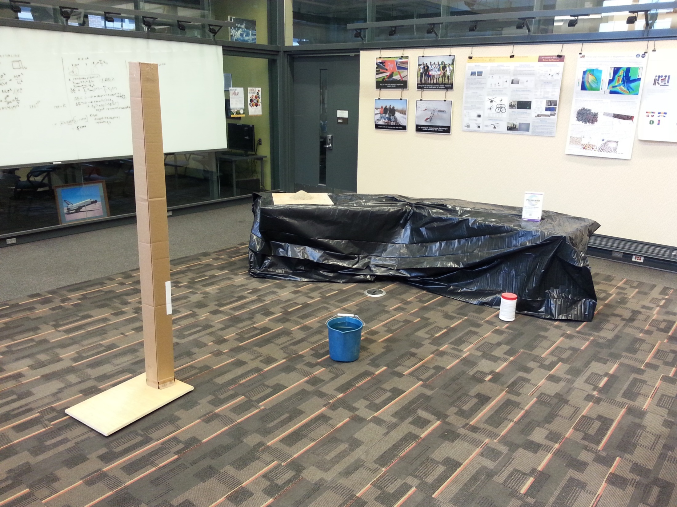
Sample area (not as large as the real one will be) with a variety
of features and targets. Notice that the repetitive pattern on
the floor, once characterized, might help in mapping. Determine
size, including height, of background “mountain feature”. Also
measure ambient conditions for the whole region.

Slide 3
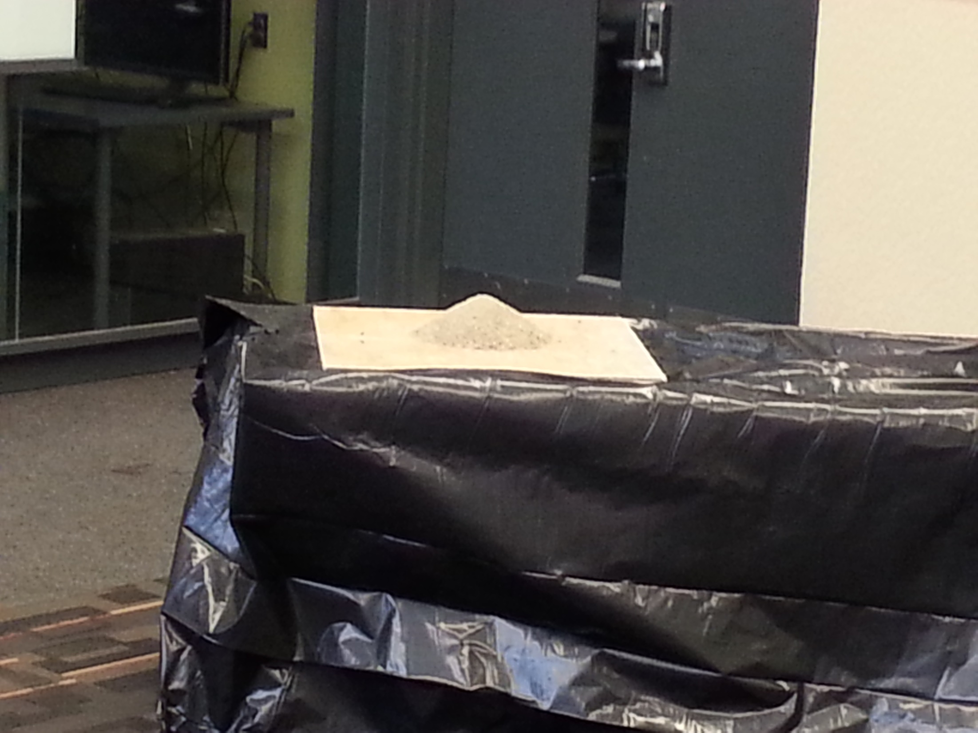
“Granular feature” – try to collect at least a 1 cubic cm sample.
Also check for potential differences from ambient conditions.

Slide 4
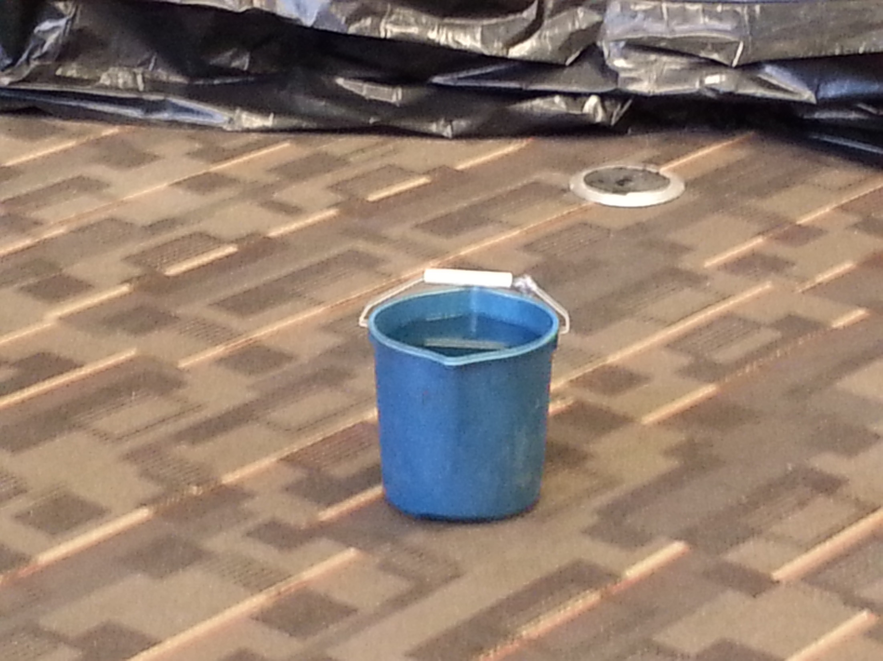
“Fluid feature” – try to collect at least a 1 cubic cm sample.
Also check for potential differences from ambient conditions.

Slide 5
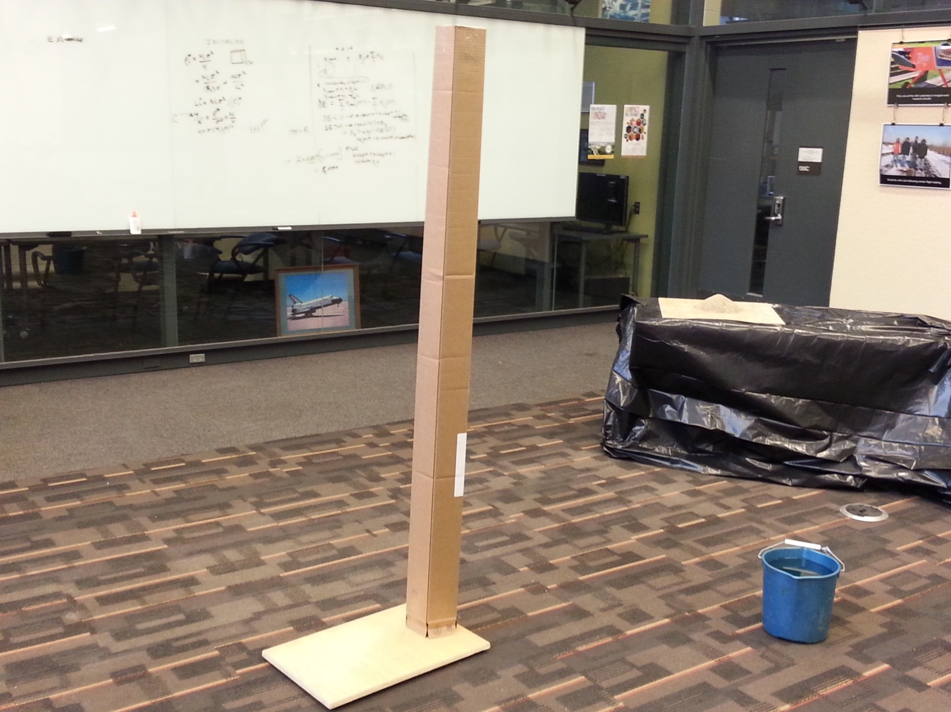
“Tower feature” – characterize its dimensions, including height.
Potential high-res imaging targets on the top or back side.

Slide 6
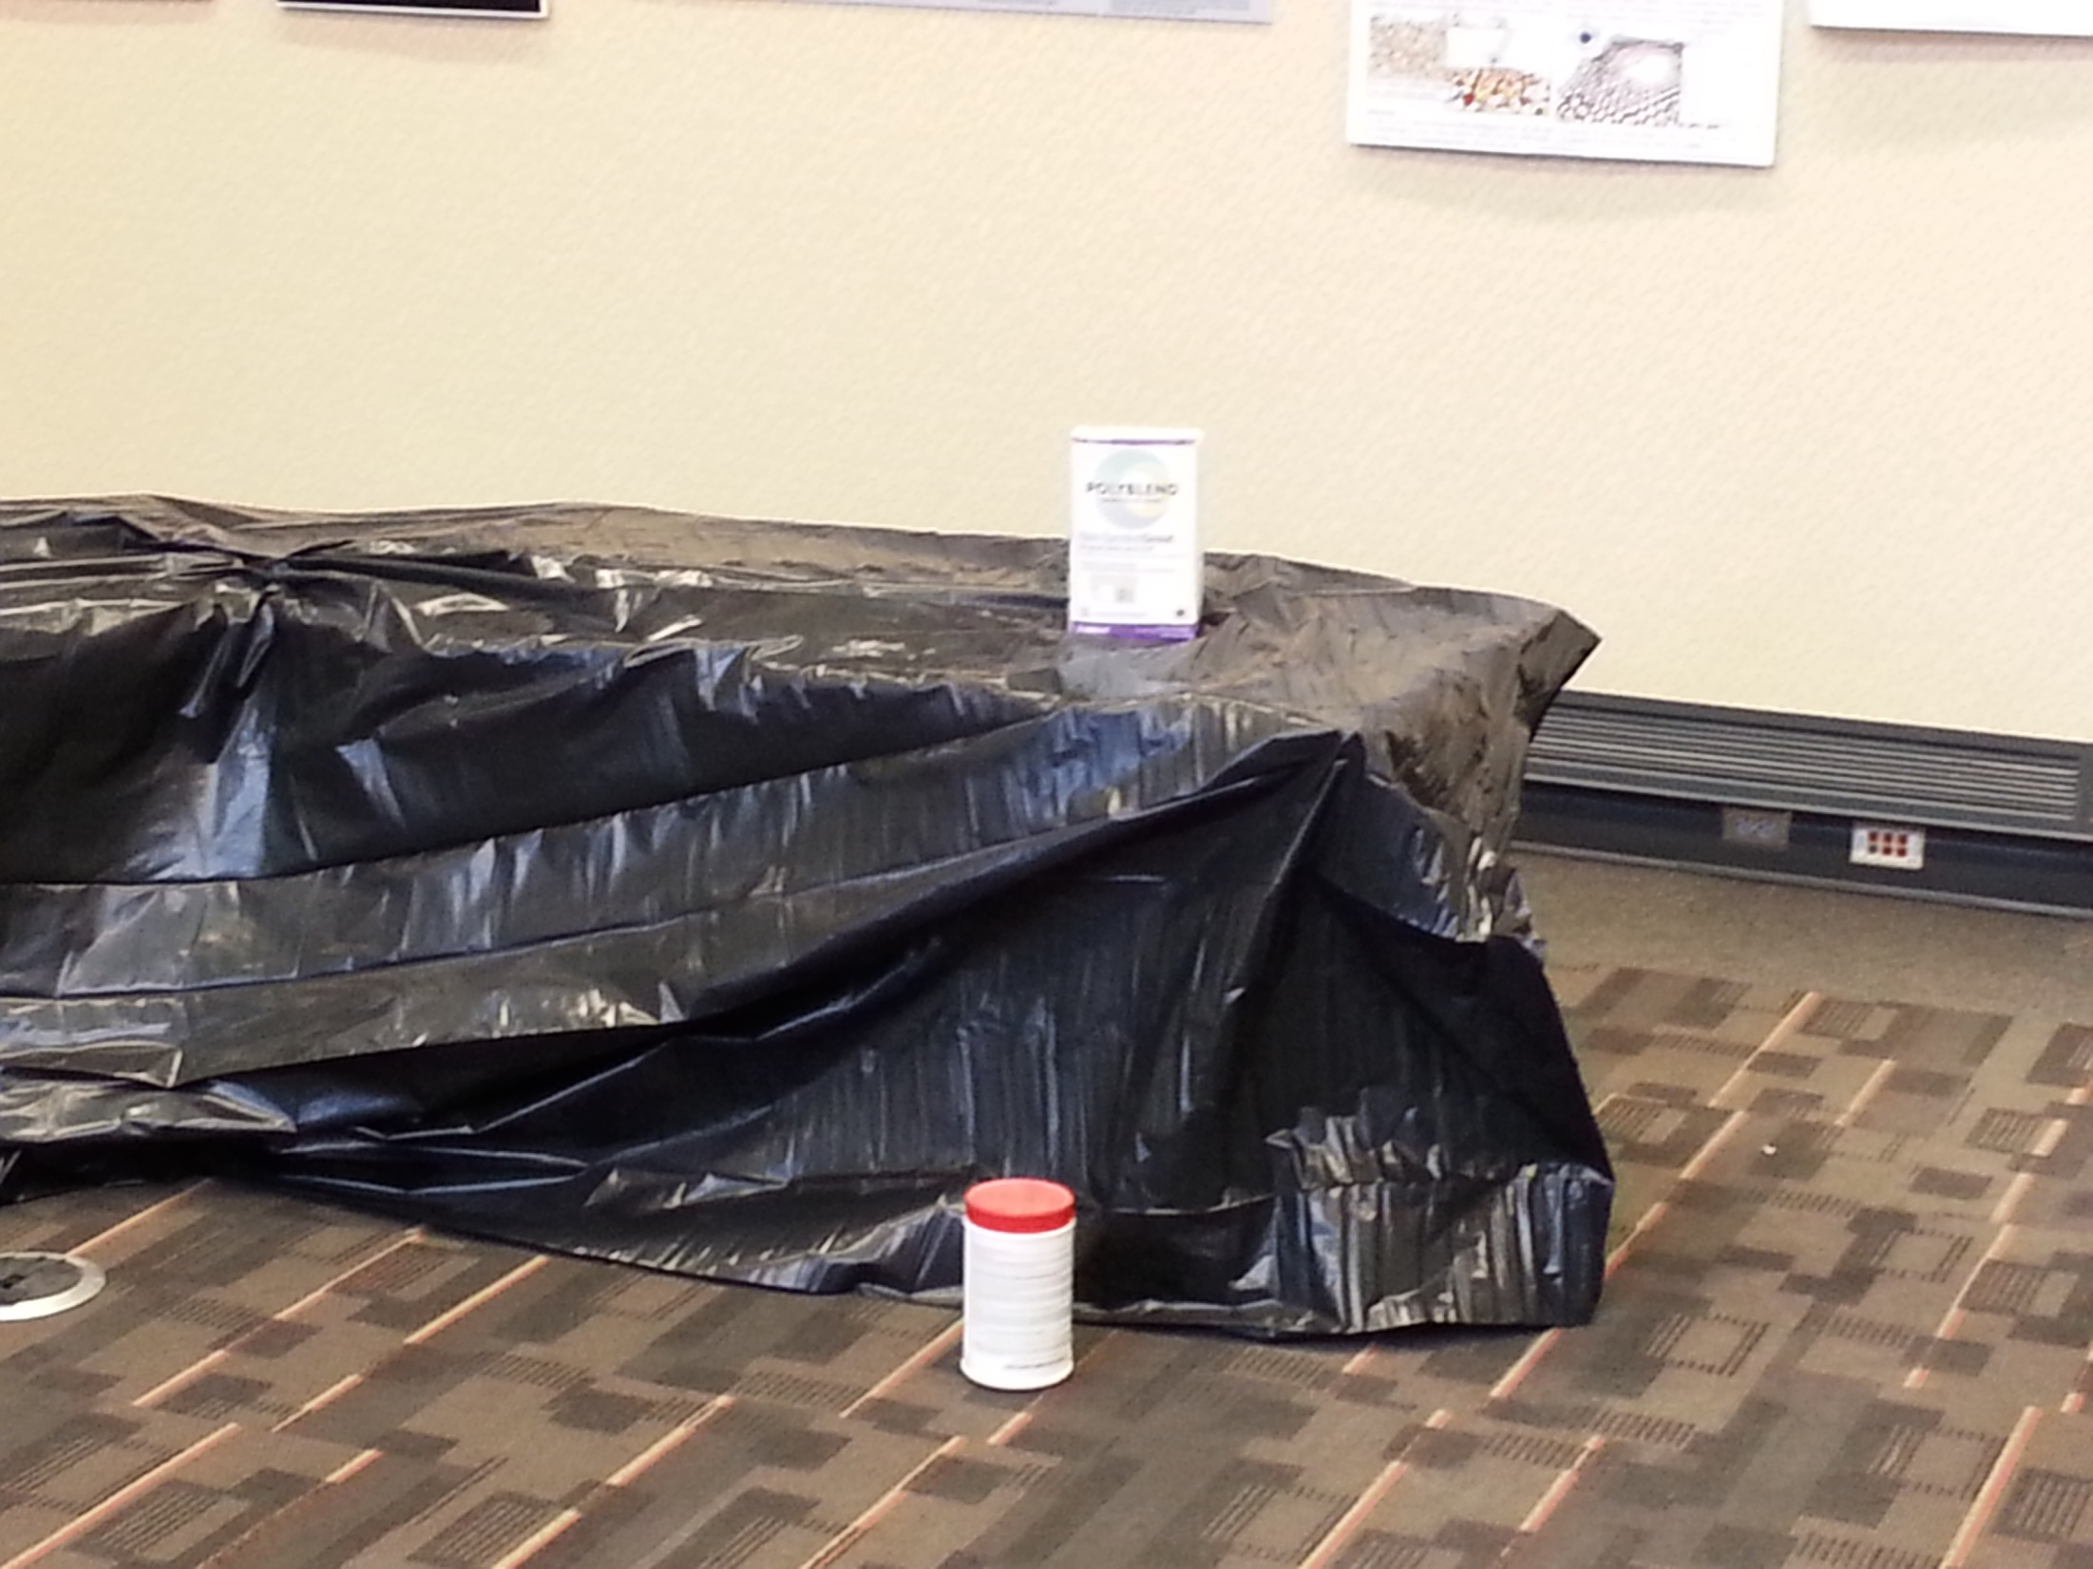
Two additional generic targets All anomalies will be located within
well-defined targets, so you can focus your exploration on them.

