Slide 1
MN Space Grant Community College Quadcopter Competition Photos on TCF Bank Stadium field U of MN – Twin Cities April 16, 2015
Photos by James Flaten
MN Space Grant / U of MN

Slide 3
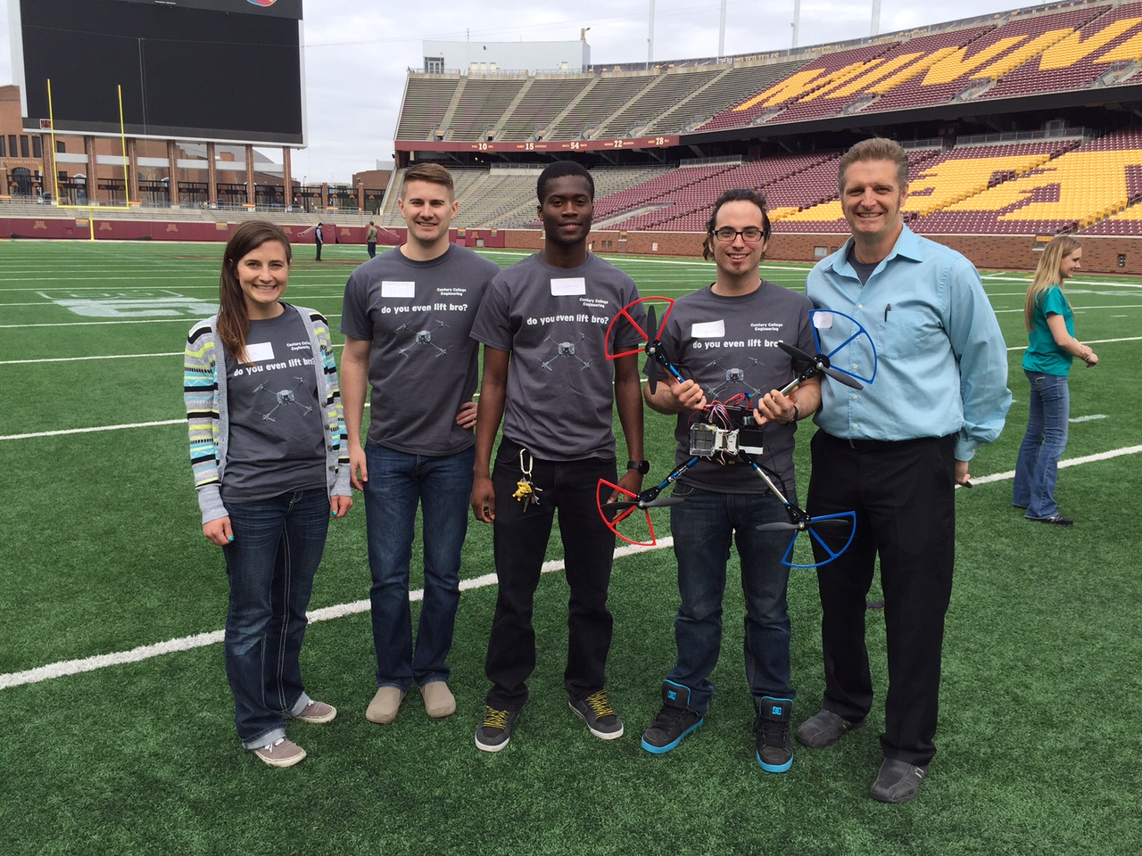

Slide 4
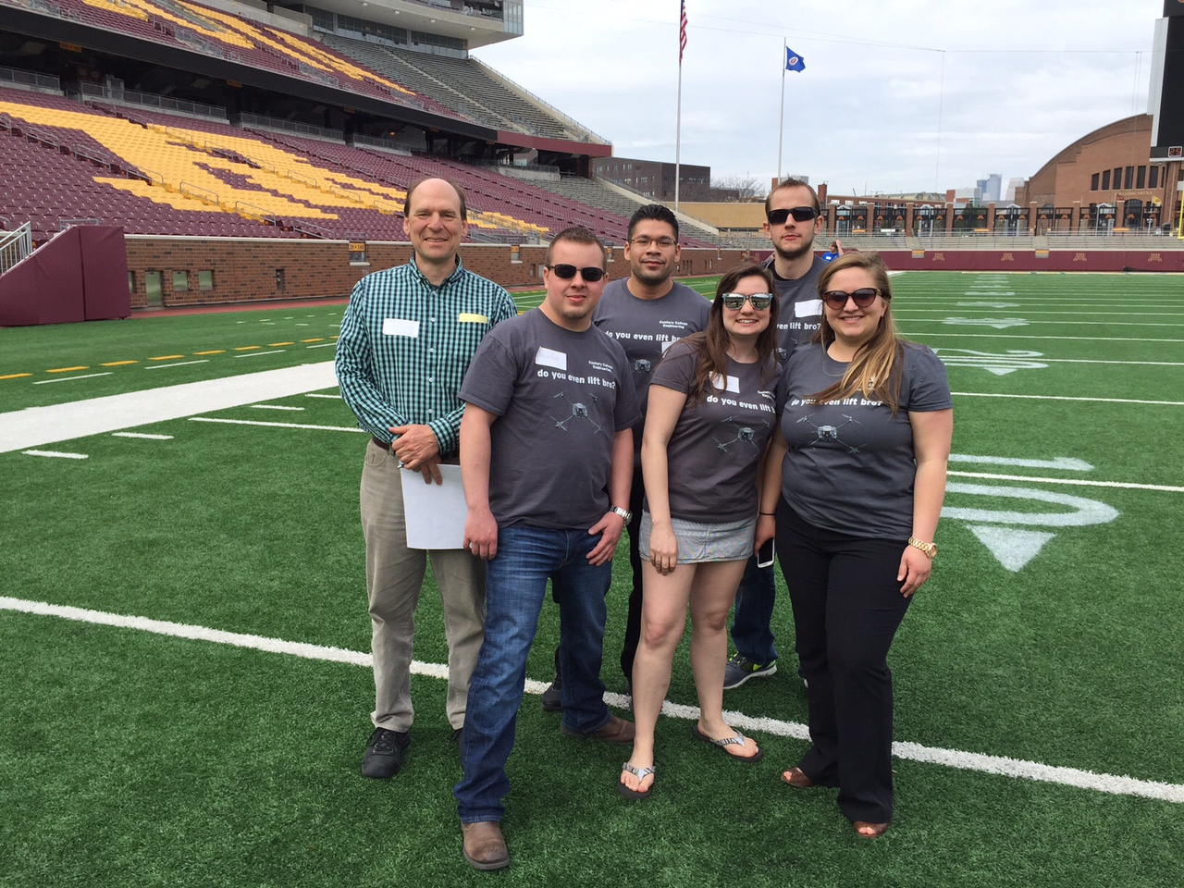

Slide 5
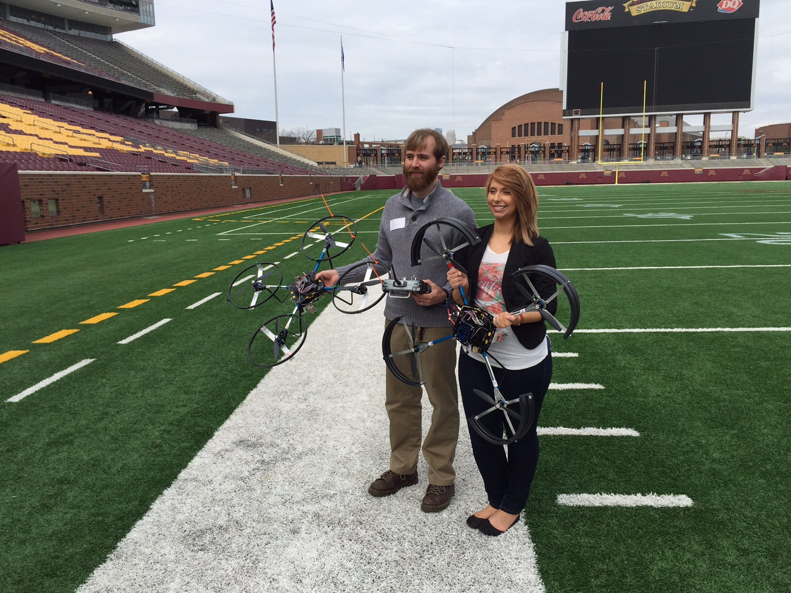

Slide 6
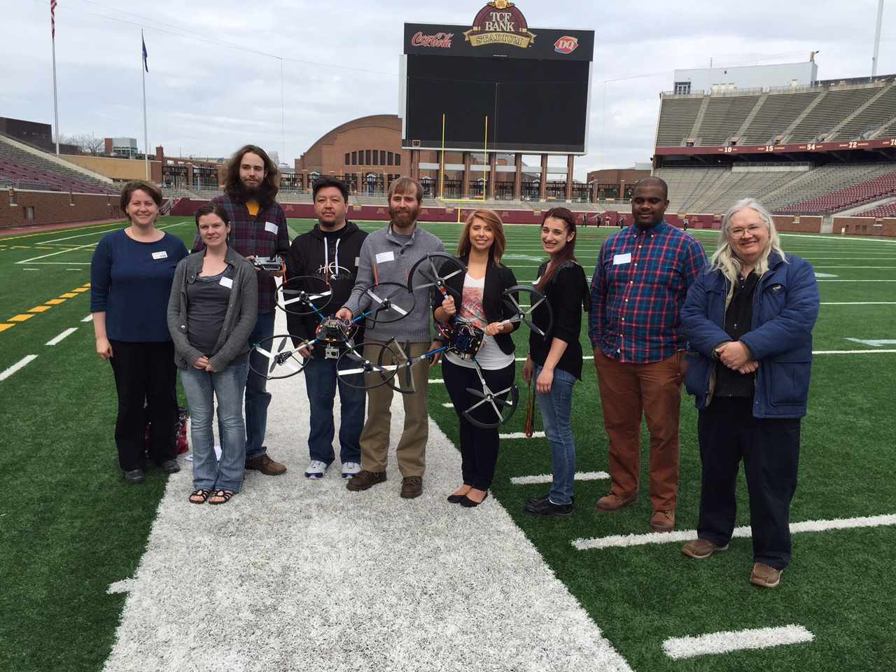

Slide 7
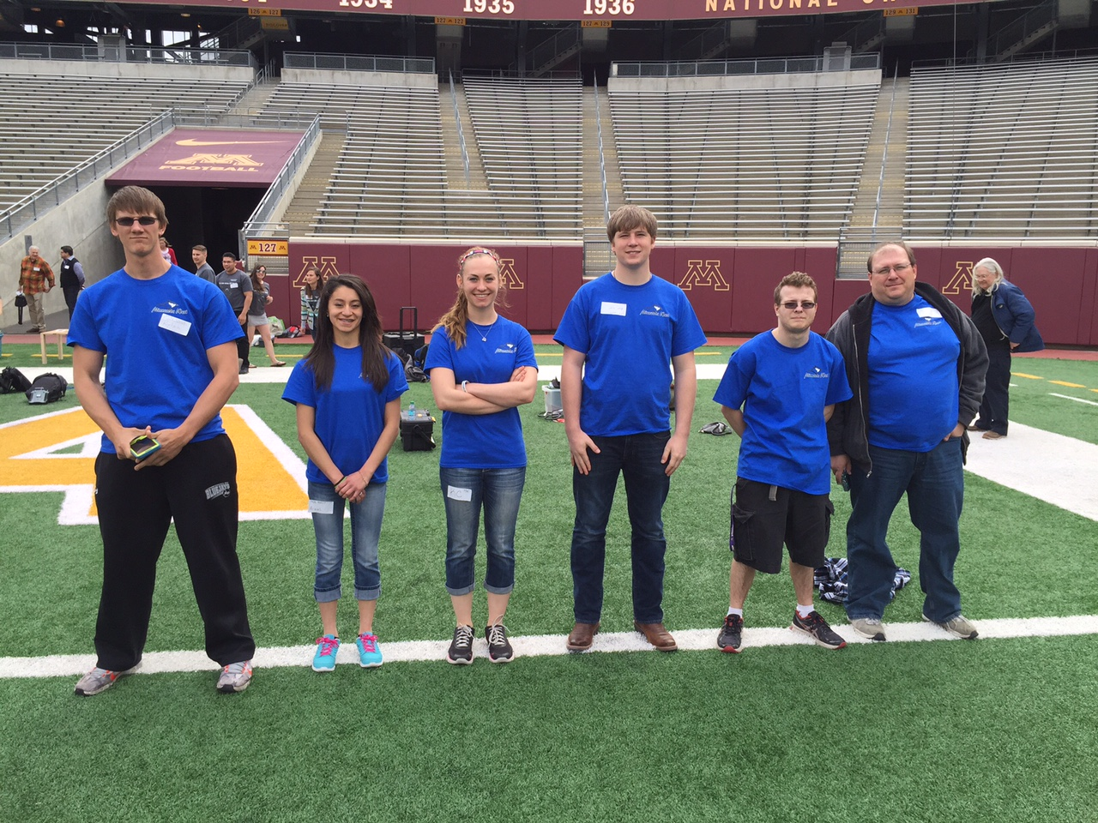

Slide 8
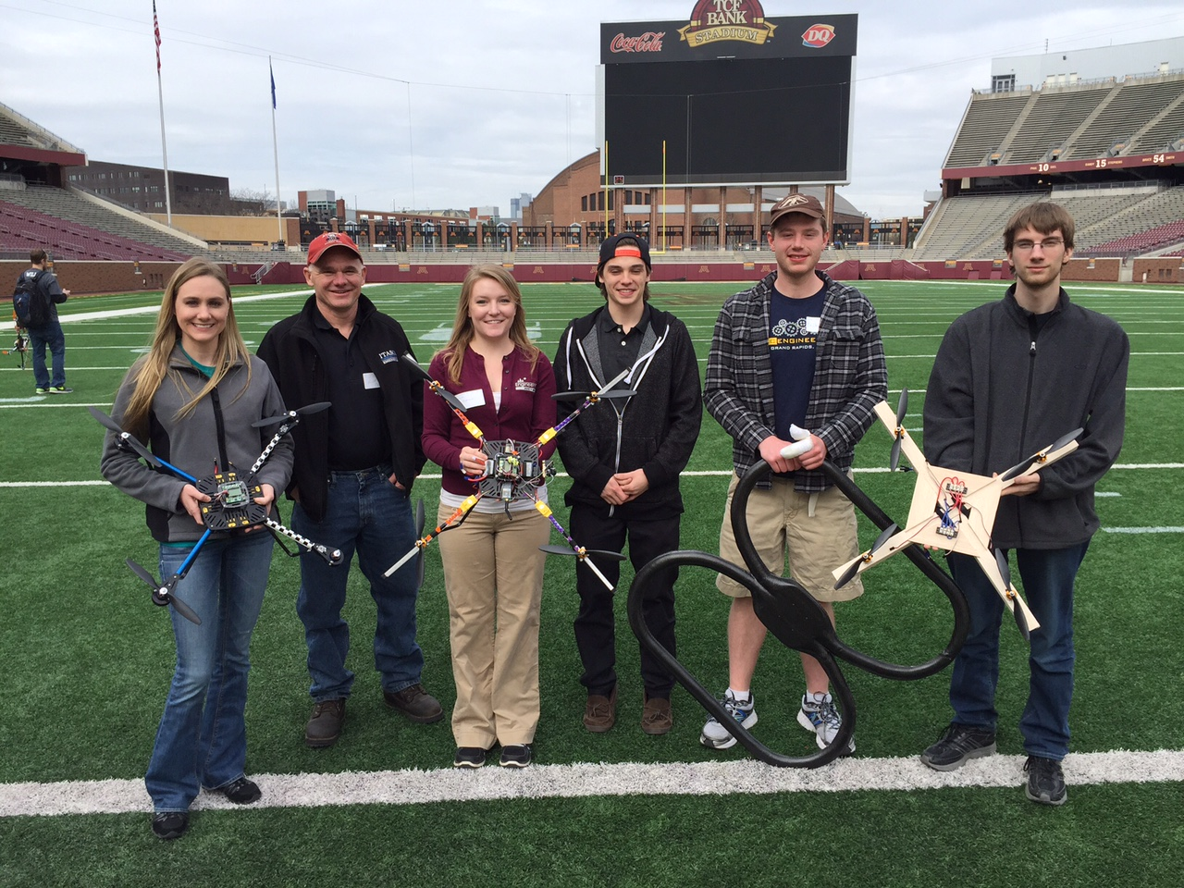

Slide 9
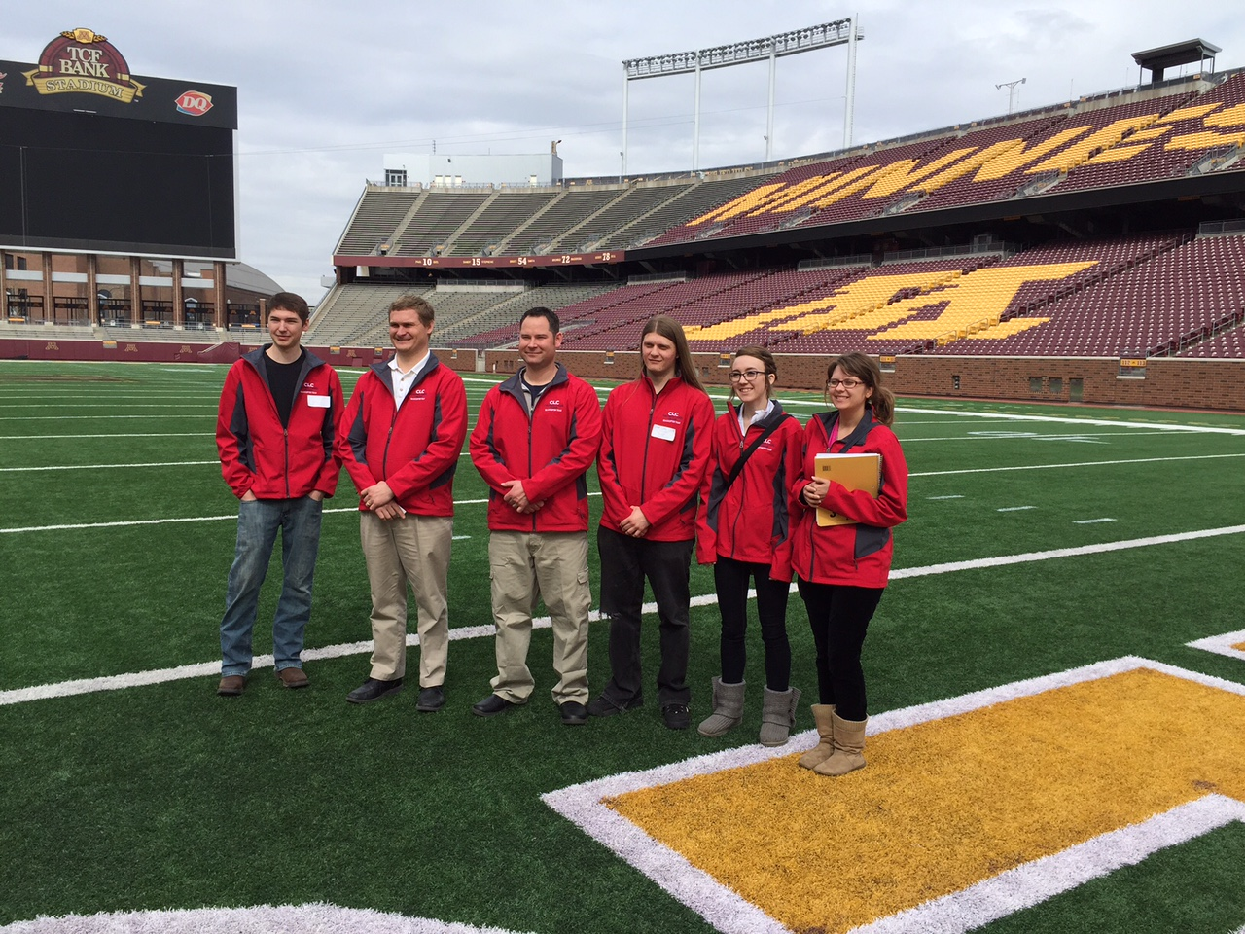

Slide 10
