Slide 1
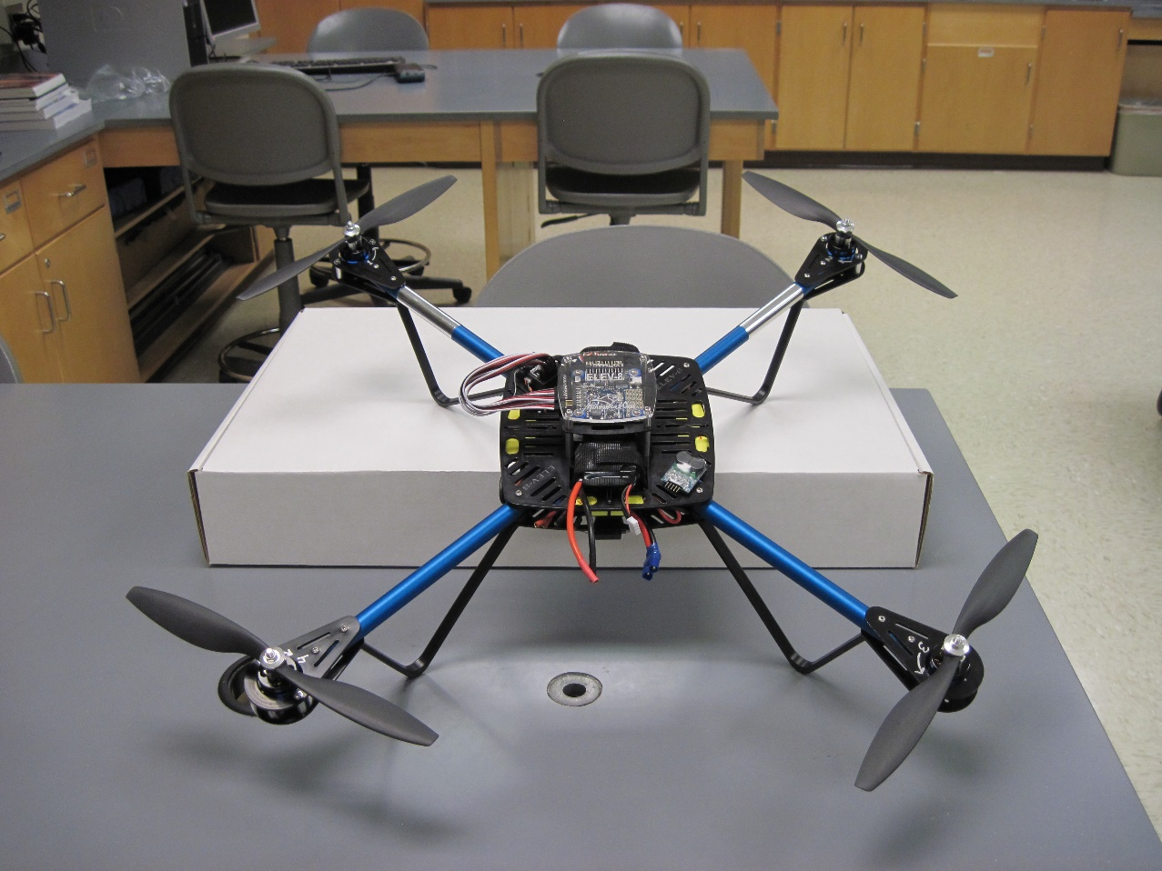
NASA’s MN Space Grant Consortium (MnSGC) Community College Quadcopter Competition
James Flaten
Associate Director of the
MN Space Grant
U of MN – Twin Cities
Aerospace Engineering and
Mechanics Department

Slide 2
NASA’s MN Space Grant Consortium (MnSGC) Community College Quadcopter Competition
Underlying goals of the solicitation
(STEM stands for “Science, Technology, Engineering, & Mathematics”
Increase the number of community college students who graduate with STEM degrees and get jobs in STEM areas or transfer to STEM programs at four-year institutions
Increase the ability of community college faculty members to deliver aerospace-related content in areas of interest to NASA
Enhance the diversity of students pursing STEM education at (Minnesota) community colleges.

Slide 3
NASA’s MN Space Grant Consortium (MnSGC) Community College Quadcopter Competition
The concept we elected to pursue
Engage Community College students by establishing an annual Quadcopter Competition in which student teams build a quadcopter from a kit then creatively outfit it to “explore” a room-sized course, taking photographs (for mapping), logging sensor data, and collecting samples.
Learn (a) electronics-build skills, (b) microcontroller programming to log sensor data, (c) CAD to 3-D print custom camera mounts and sample-return mechanisms, and (d) data analysis techniques, including map-generation from photos and/or video.

Slide 4
NASA’s MN Space Grant Consortium (MnSGC) Community College Quadcopter Competition
Expectations
Recruit 7 five-person student teams at 5 Community Colleges, spread around the state of Minnesota.
Each Community College provides (at least) one faculty adviser per student team. Advisers receive compensation (either ~2-credit course release or overload pay).
Each five-person student team contributes to diversity goals – at least 40% women and at least 20% underrepresented.
Student participants will achieve the “significant engagement” level over the course of one year with $2500+ in scholarships and at 80+ hours in total time on task. Different students will be involved in Year 2.
The U of MN – Twin Cities, lead institution of the MnSGC, hosts the spring competition, runs training workshops for advisers and student teams, and provides additional (remote) mentoring through bi-weekly telecons/videocons.

Slide 5
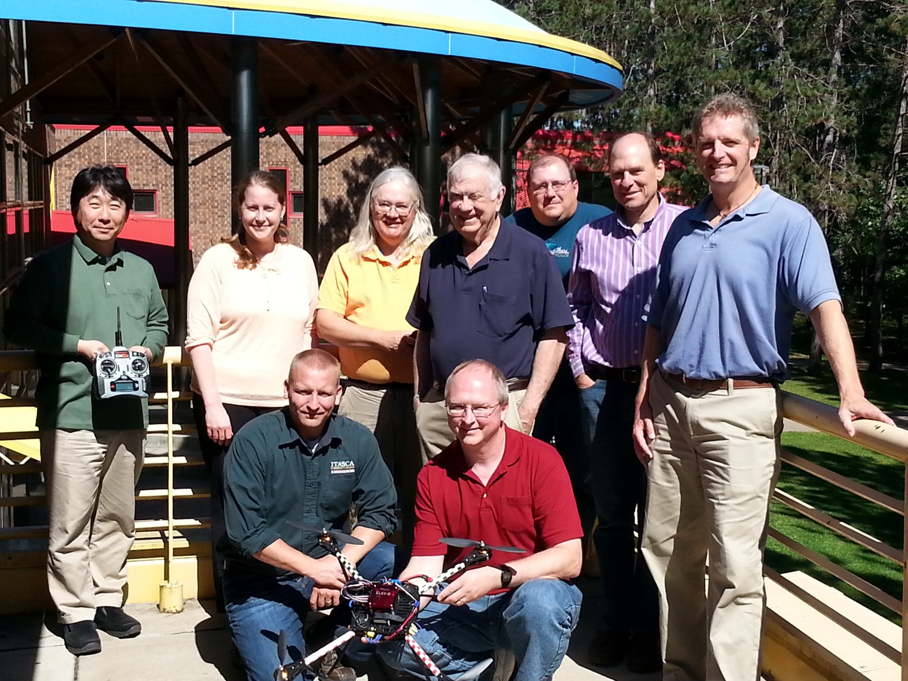
NASA’s MN Space Grant Consortium (MnSGC) Community College Quadcopter Competition
Participating faculty

Slide 6
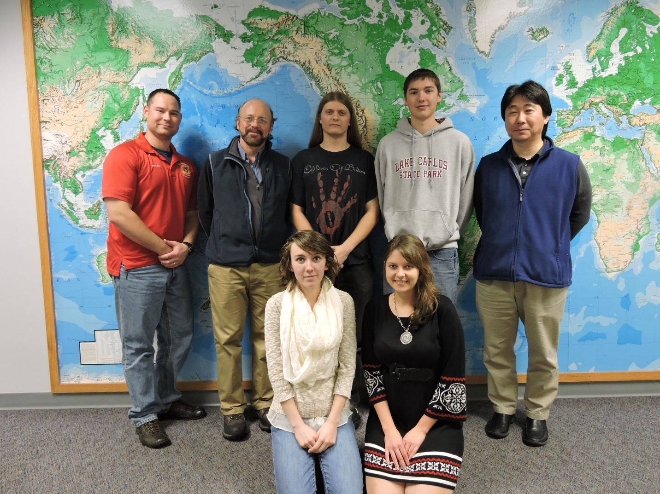
NASA’s MN Space Grant Consortium (MnSGC) Community College Quadcopter Competition
Participating teams
Central Lakes College, Brainerd & Staples campuses

Slide 7
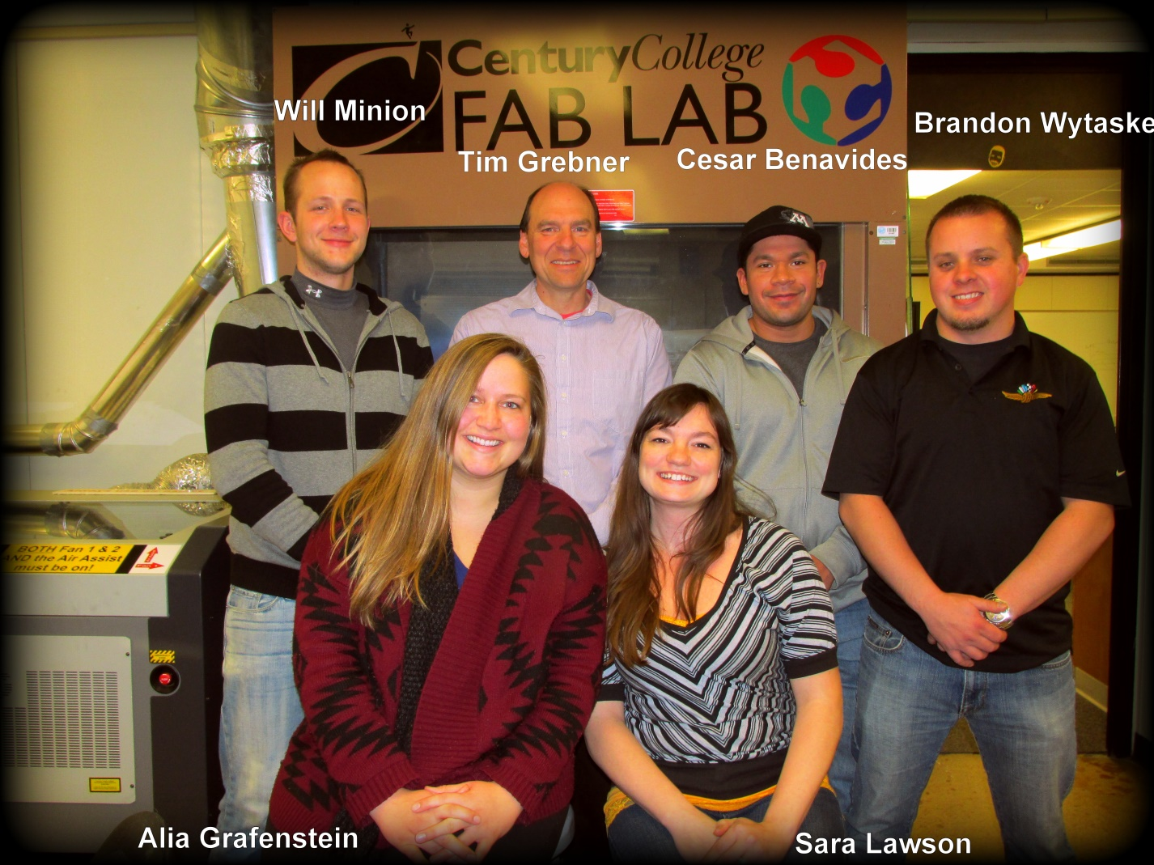
NASA’s MN Space Grant Consortium (MnSGC) Community College Quadcopter Competition
Participating teams
Century College, White Bear Lake – Team A

Slide 8
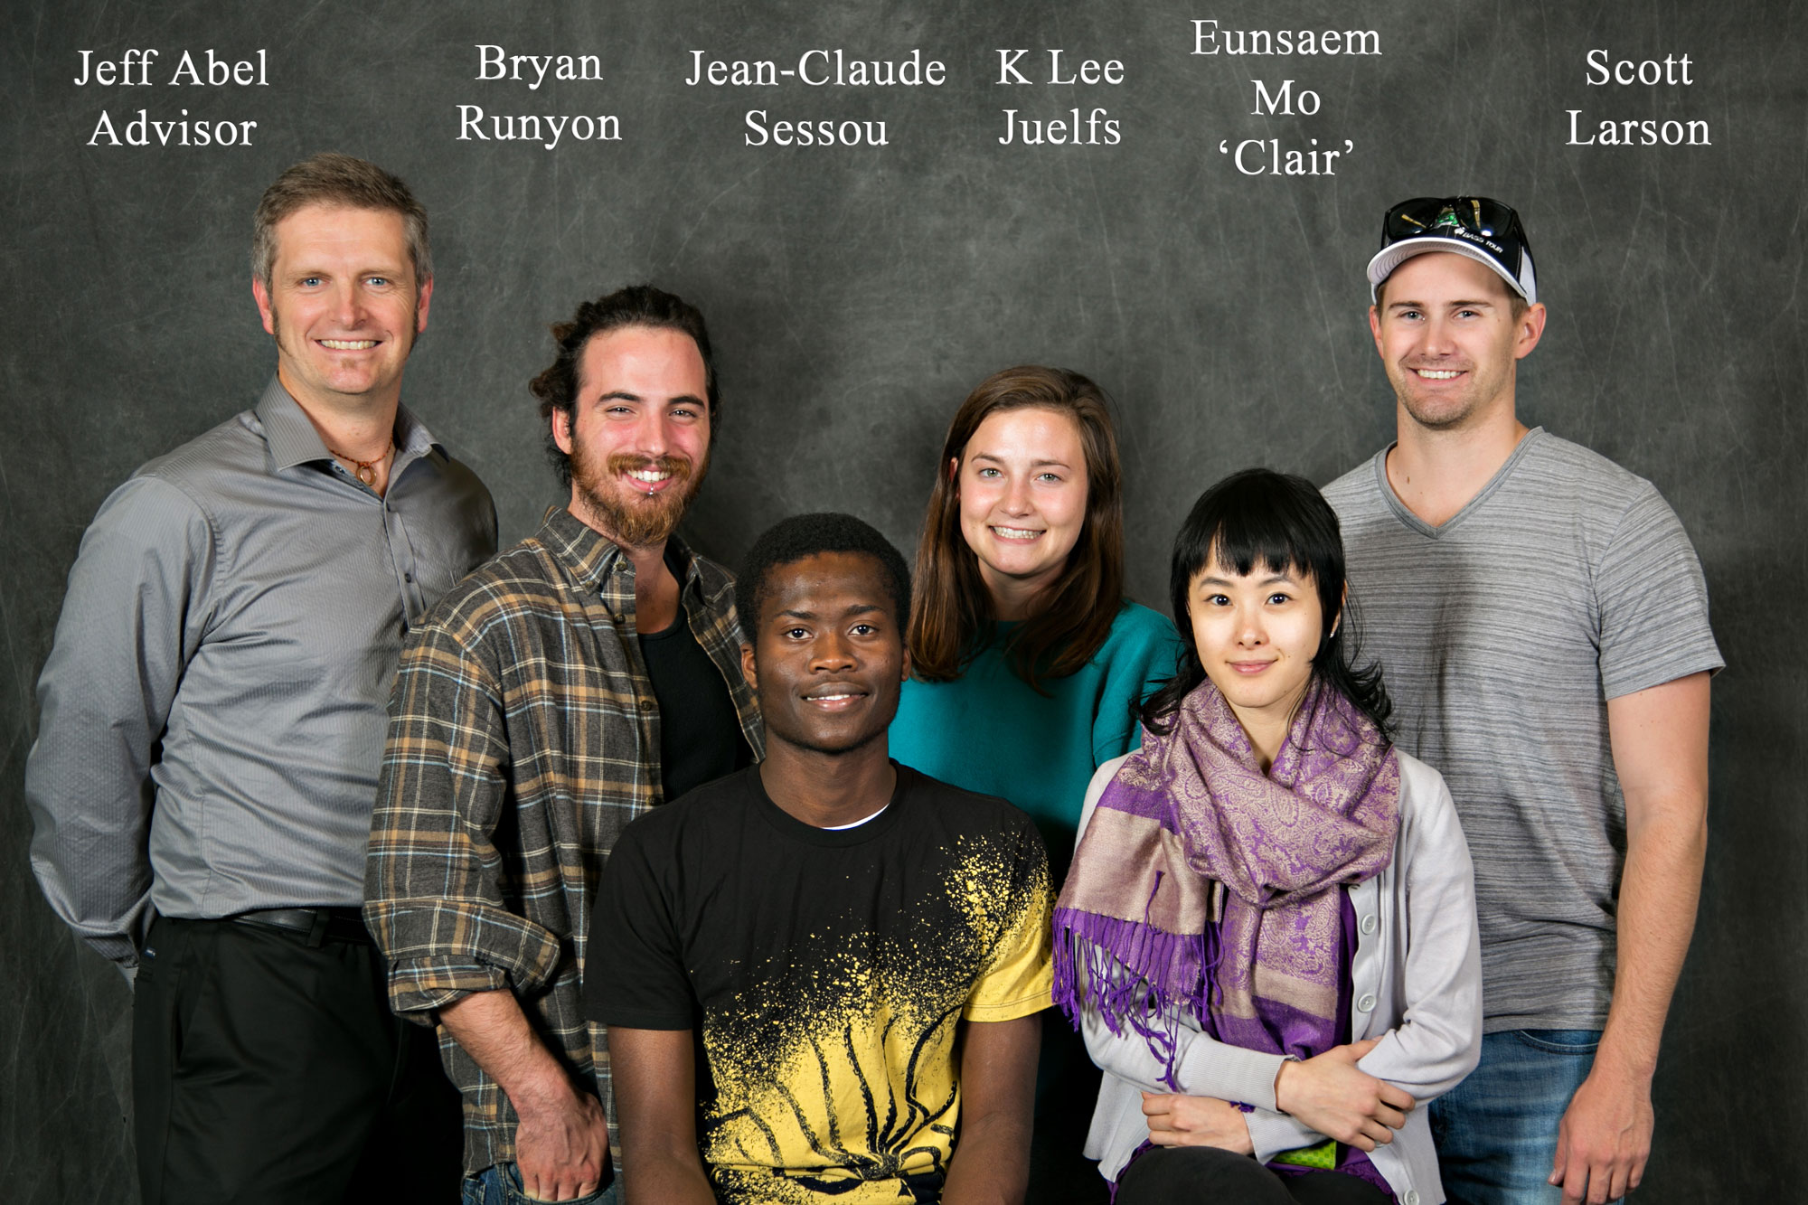
NASA’s MN Space Grant Consortium (MnSGC) Community College Quadcopter Competition
Participating teams
Century College, White Bear Lake – Team B

Slide 9
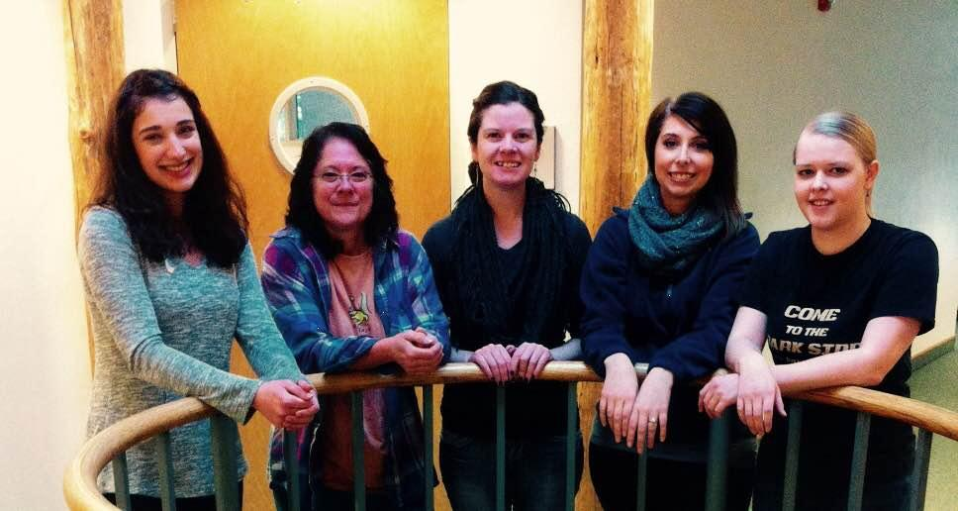
NASA’s MN Space Grant Consortium (MnSGC) Community College Quadcopter Competition
Participating teams
Fond du Lac Tribal and Community College, Cloquet - women

Slide 10
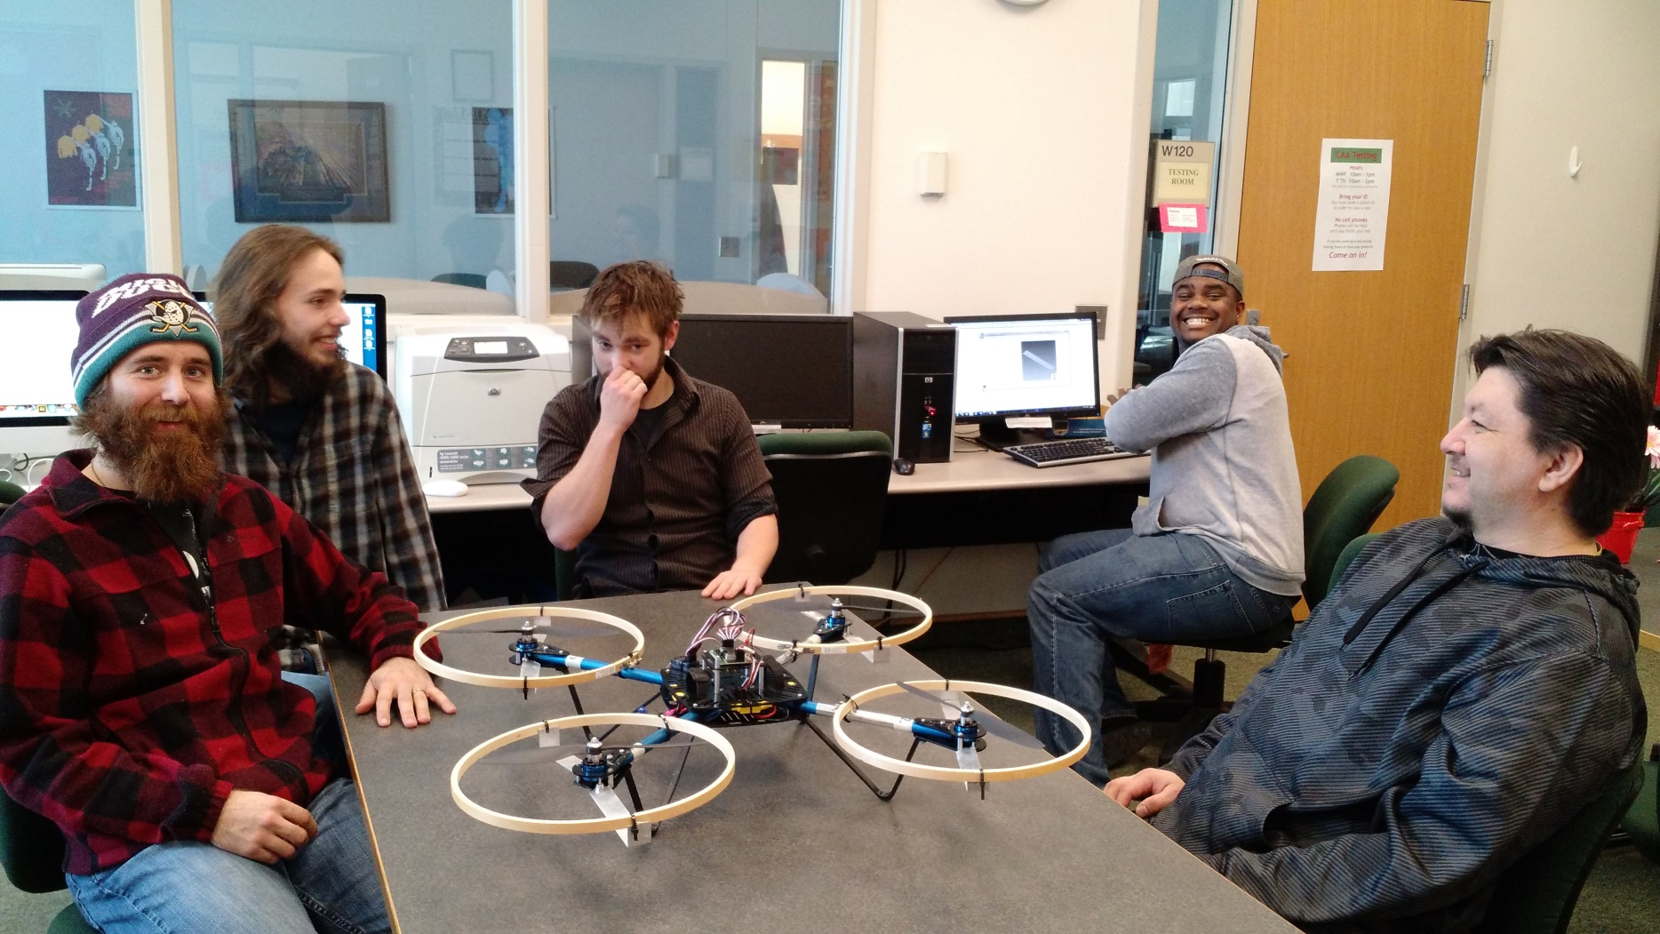
NASA’s MN Space Grant Consortium (MnSGC) Community College Quadcopter Competition
Participating teams
Fond du Lac Tribal and Community College, Cloquet - men

Slide 11
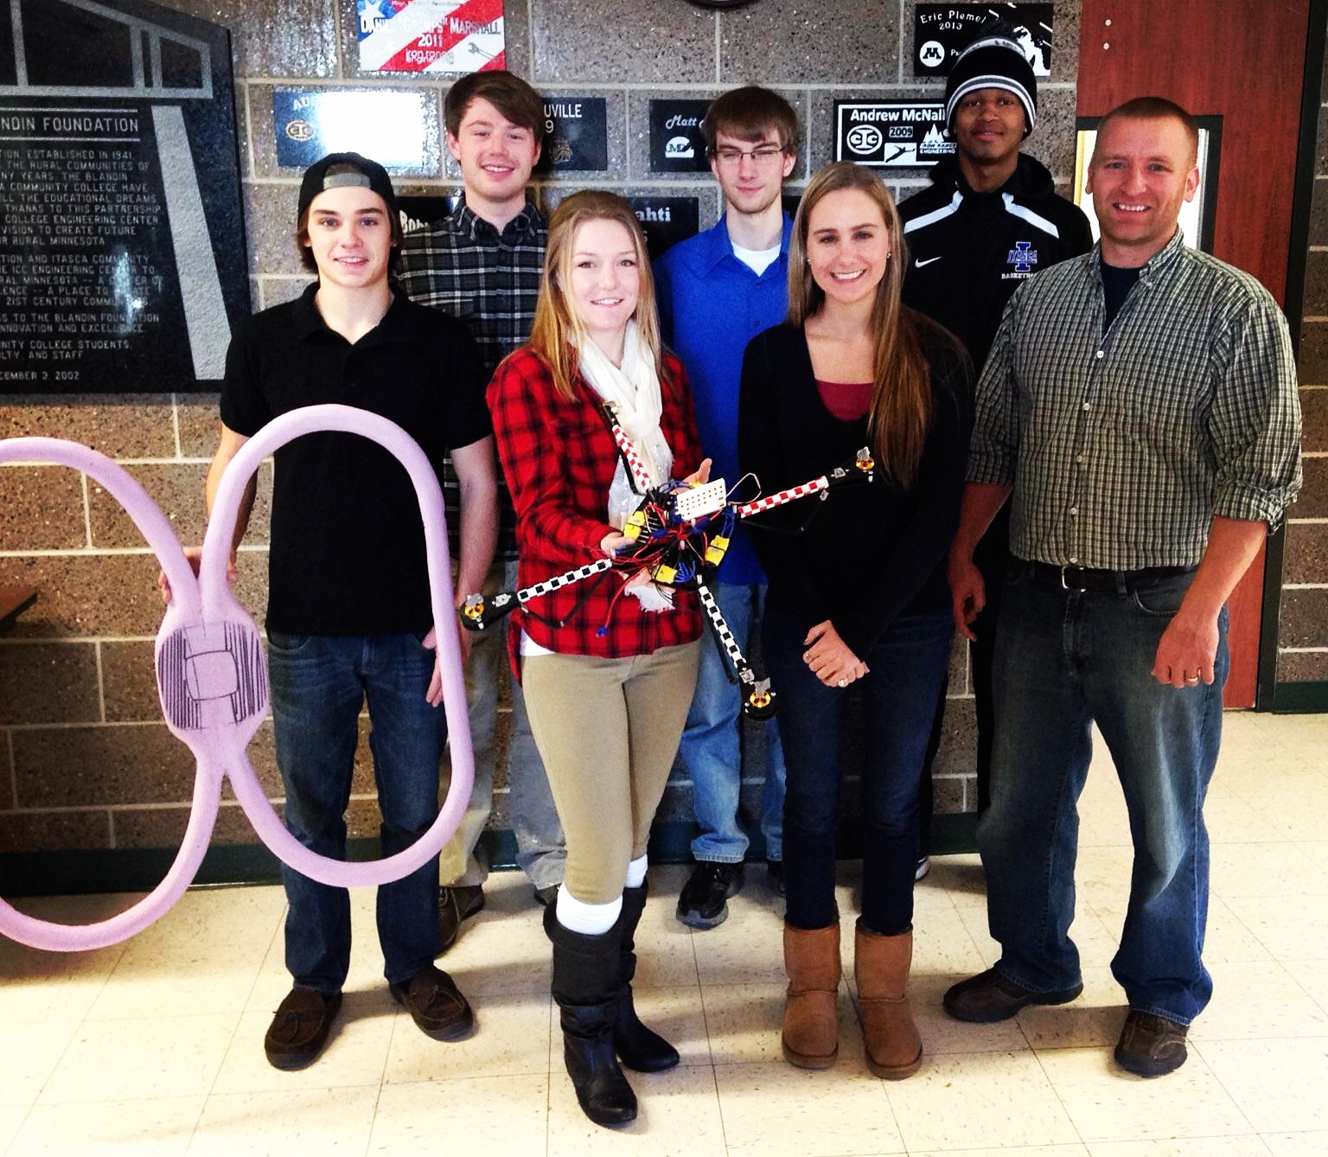
NASA’s MN Space Grant Consortium (MnSGC) Community College Quadcopter Competition
Participating teams
Itasca Community College, Grand Rapids

Slide 12
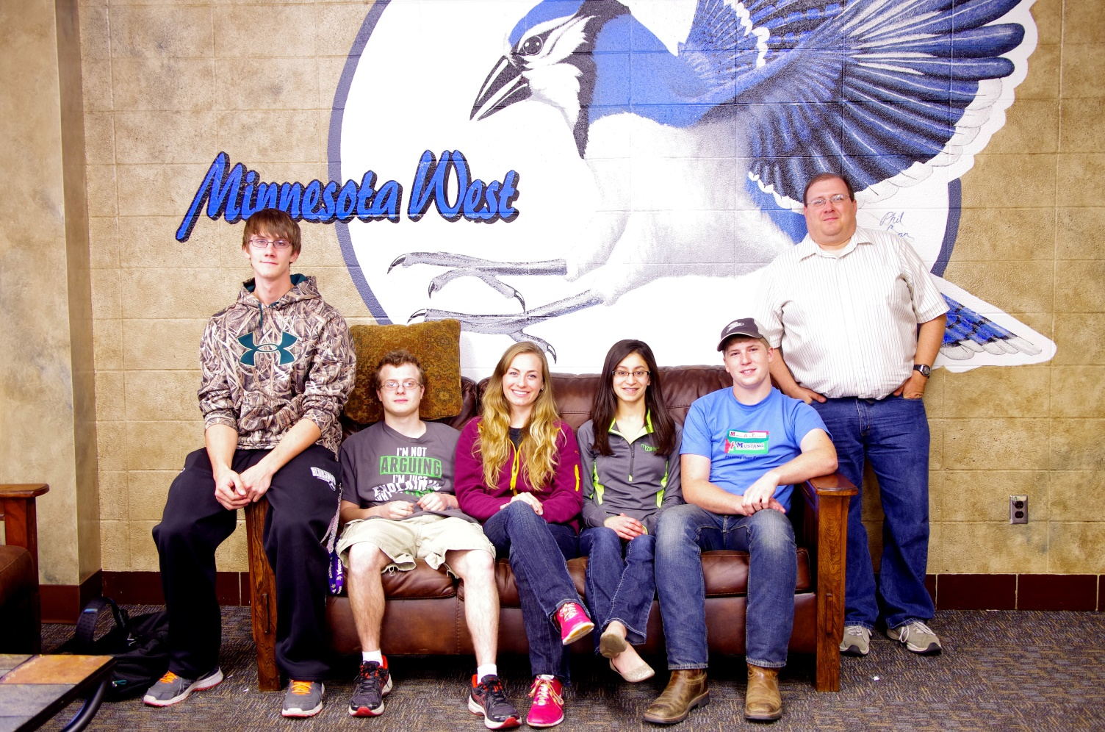
NASA’s MN Space Grant Consortium (MnSGC) Community College Quadcopter Competition
Participating teams
MN West Community and Technical College, Worthington campus

Slide 13
Overview of the Competition/Challenge timeline
Fall semester
Adviser training workshop
Recruit student participants
Pre-program survey
Attend “Kick-off” (training)
Learn to solder
Learn to use CAD software
Learn to program Arduino microcontrollers
Learn to do 3D printing / laser cutting
Have bi-weekly telecons or videocons with U of MN TAs (both semesters)
Build an ELEV-8 quadcopter kit
Design, CAD, build, install rotor protection on ELEV-8
Learn to fly quadcopters, possibly starting with toys, possibly using simulation software
Design modifications to accomplish competition goals
Write Preliminary Design Review (PDR): ELEV-8 progress, plans for accomplishing goals
Fall “Educational Enhancement” event
Spring semester
Adviser surveys and telecons
NASA Armstrong videocon
Implement and test modifications to accomplish competition goals
Mid-program in-person interviews/assessment with MnSGC (Prof. Flaten)
Spring “Educational Enhancement” event
“On-campus” and “off-campus” outreach event (at least one of each)
Write Critical Design Review(CDR): update on ELEV-8 modifications and testing
Demonstrate quadcopter capabilities at competition in April 2015
Oral Flight-Readiness Review(FRR): modified ELEV-8, test results
Write Post-competition Final Report: present competition results (e.g. maps, sensor data, etc.)
Post-program survey
NASA longitudinal tracking through “first step” (beyond current institution)

Slide 14
NASA’s MN Space Grant Consortium (MnSGC) Community College Quadcopter Competition
Competition/Challenge Goals for “Year 1”
(in addition to building the ELEV-8 kit
and generating required reports)
10% Video: 1-2 minutes long, to possibly post on YouTube, peer-rated at the April competition
10% Rotor protection: CAD-drawn (at least), required while learning to fly ELEV-8 quadcopter
10% Multi-pilot: at least 3 team members must demonstrate basic flying skills, not timed
10% Camera mount: CAD-drawn, must use 3-D printing or laser cutting, out-view & down-view
10% Close-up imaging: take images (while in flight) of targets on horizontal and vertical surfaces
40% Exploration: explore a region (about 5m x 5m; timed ~10 minutes), take photos to generate maps (including elevations, real units), use Arduino-based sensors and SD-card logging to measure base values and anomalies in physical parameters (air pressure, air temperature, relative humidity, surface temperature of ground targets, magnetic field, etc.), plus sample return from fluid (water) or granular (sand/soil) targets; do as many things (well) as possible; allowed to swap out equipment
10% Unique capability: implement and demonstrate at least one unique capability, allowed to
(but not required to) help accomplish other goals, must involve flying, may be swapped equipment

Slide 15
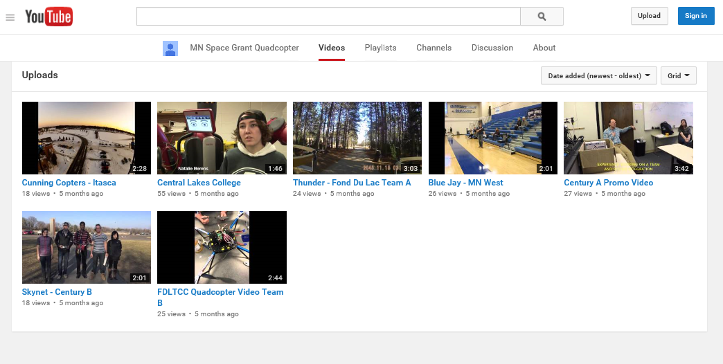
NASA’s MN Space Grant Consortium (MnSGC) Community College Quadcopter Competition
Team Videos
https://www.youtube.com/channel/UCV9ybUefy7ocQiA2zrQLtGA/videos

Slide 16
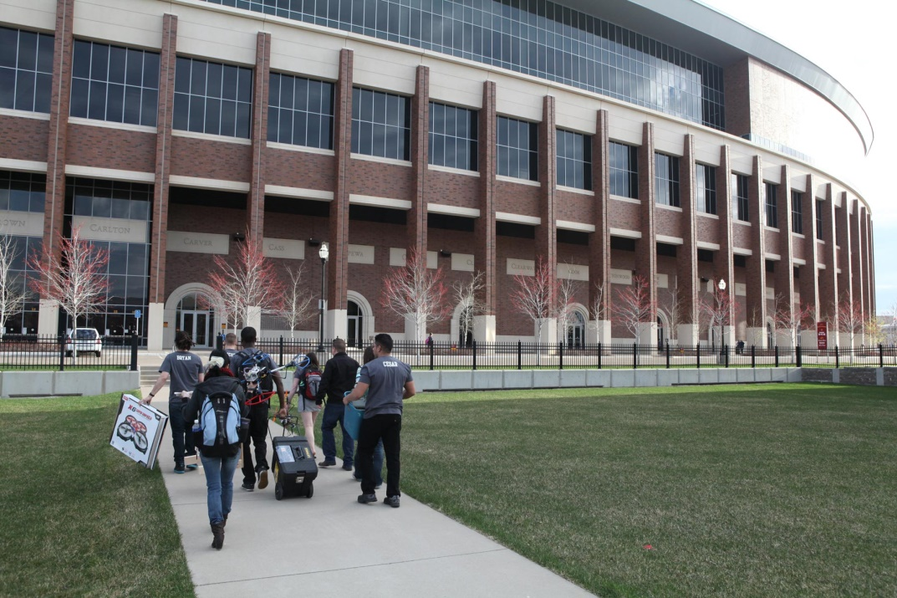
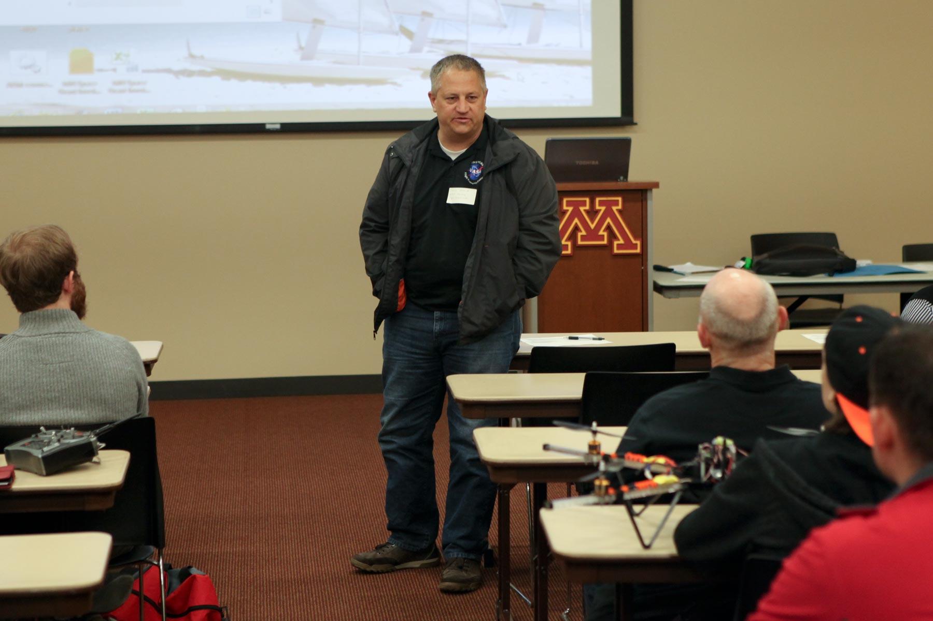
NASA’s MN Space Grant Consortium (MnSGC) Community College Quadcopter Competition
Photos from the Year 1 Competition Event

Slide 17
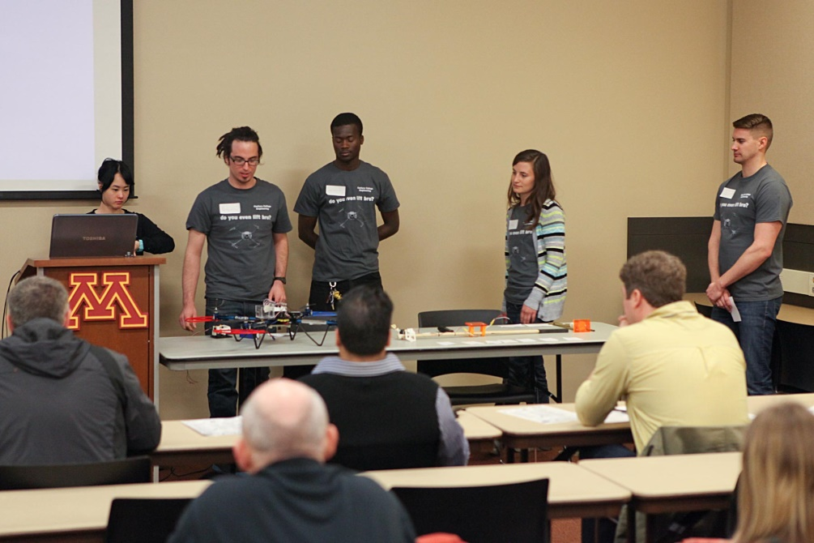
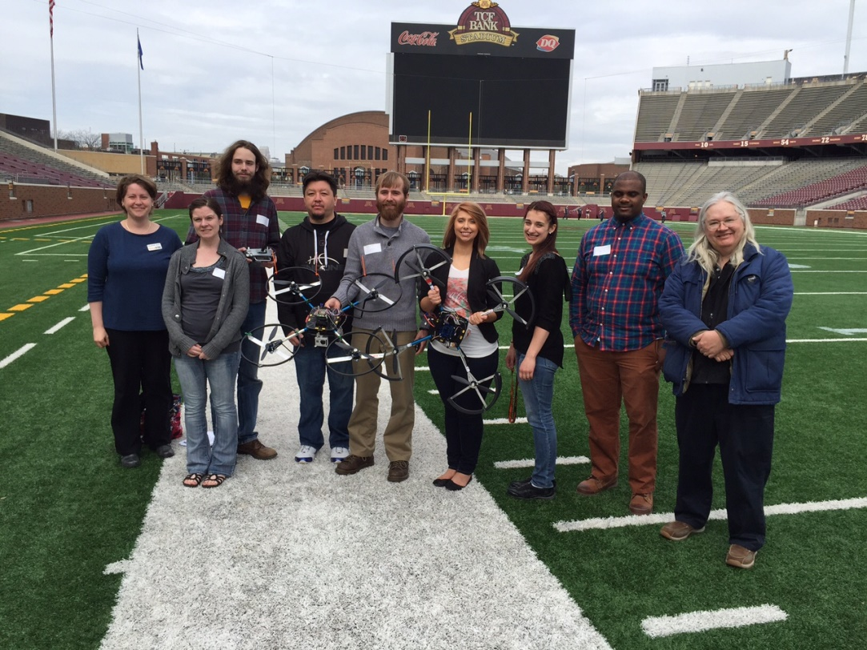
NASA’s MN Space Grant Consortium (MnSGC) Community College Quadcopter Competition
Photos from the Year 1 Competition Event

Slide 18
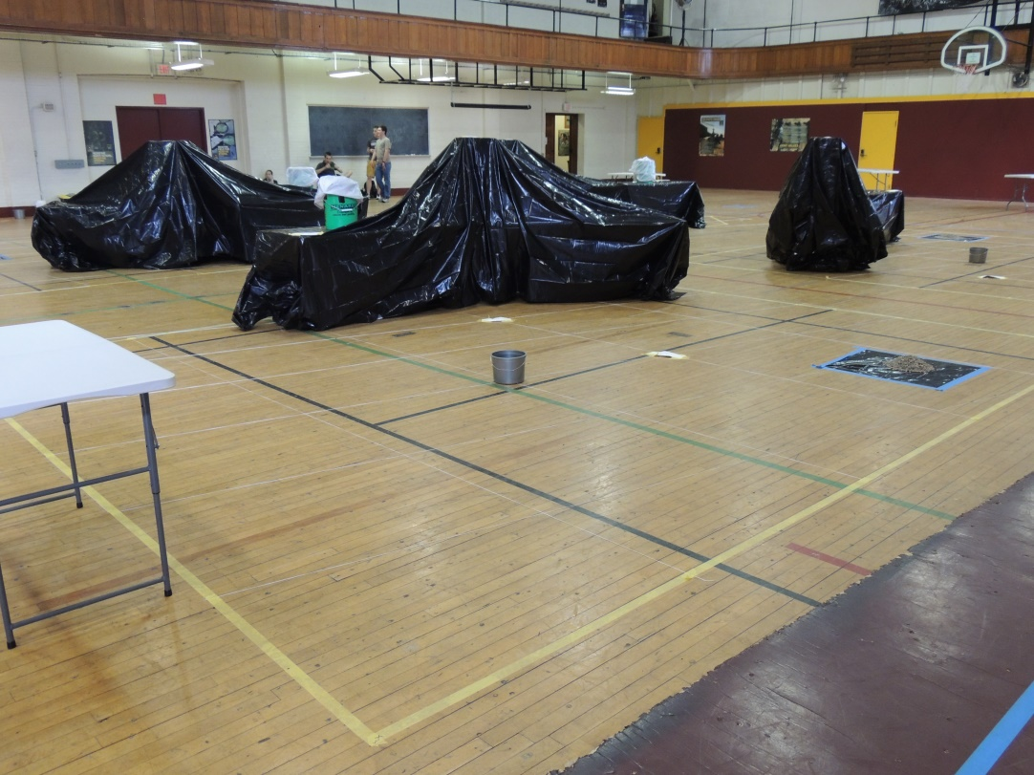
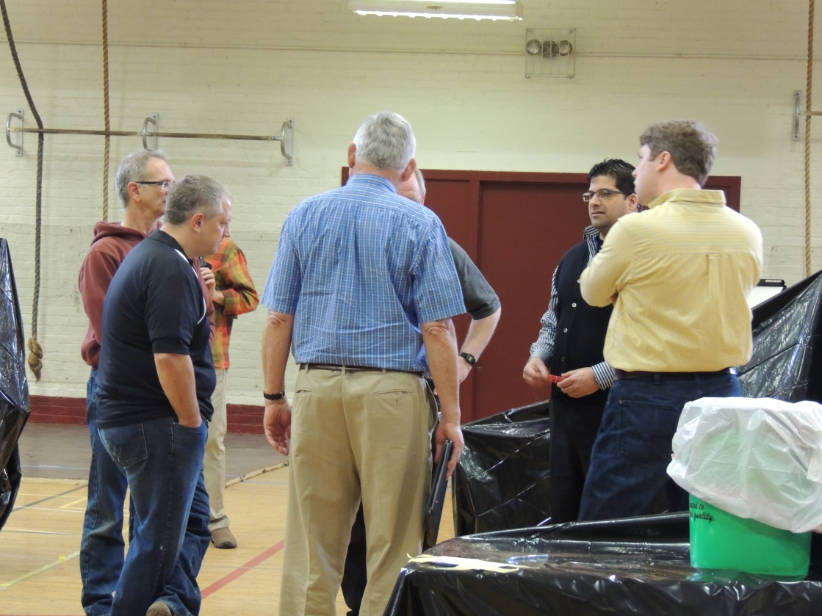
NASA’s MN Space Grant Consortium (MnSGC) Community College Quadcopter Competition
Photos from the Year 1 Competition Event

Slide 19
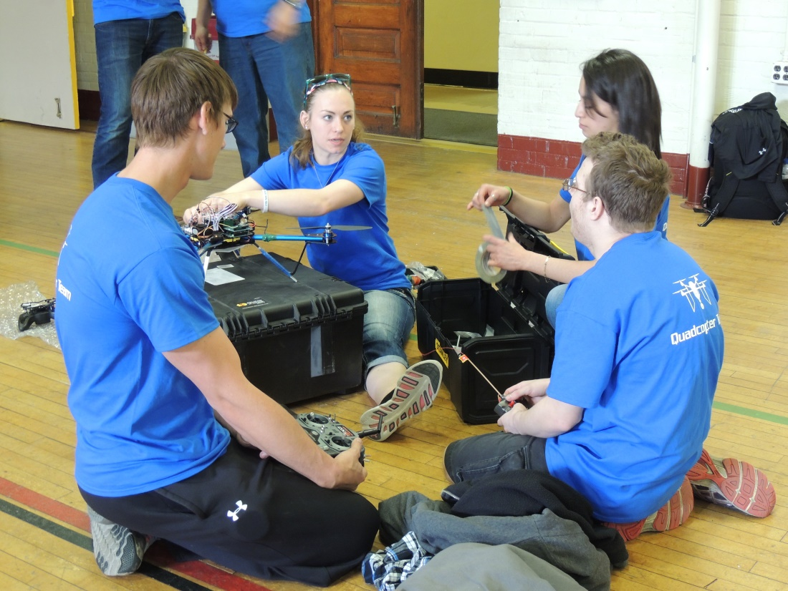
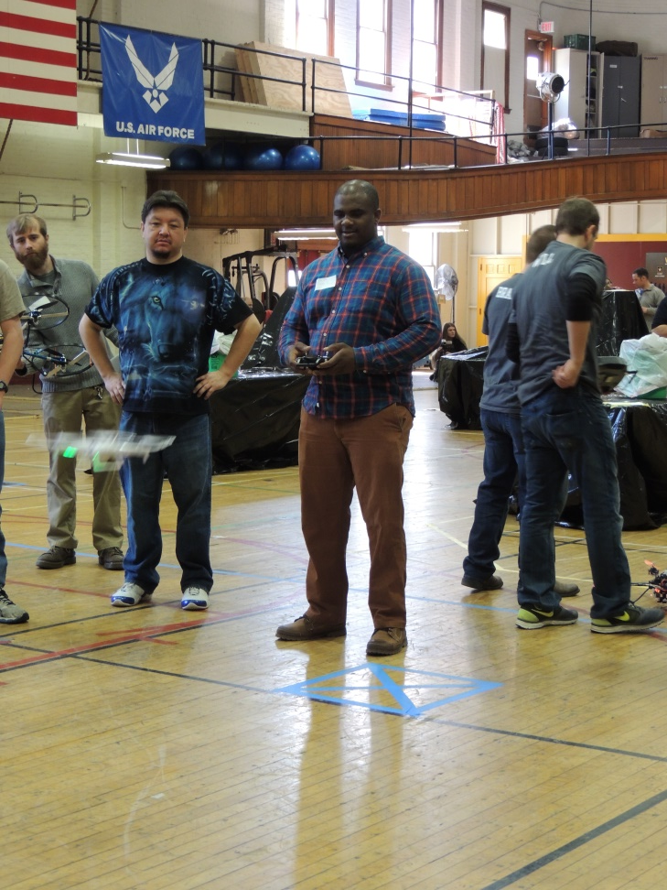
NASA’s MN Space Grant Consortium (MnSGC) Community College Quadcopter Competition
Photos from the Year 1 Competition Event

Slide 20
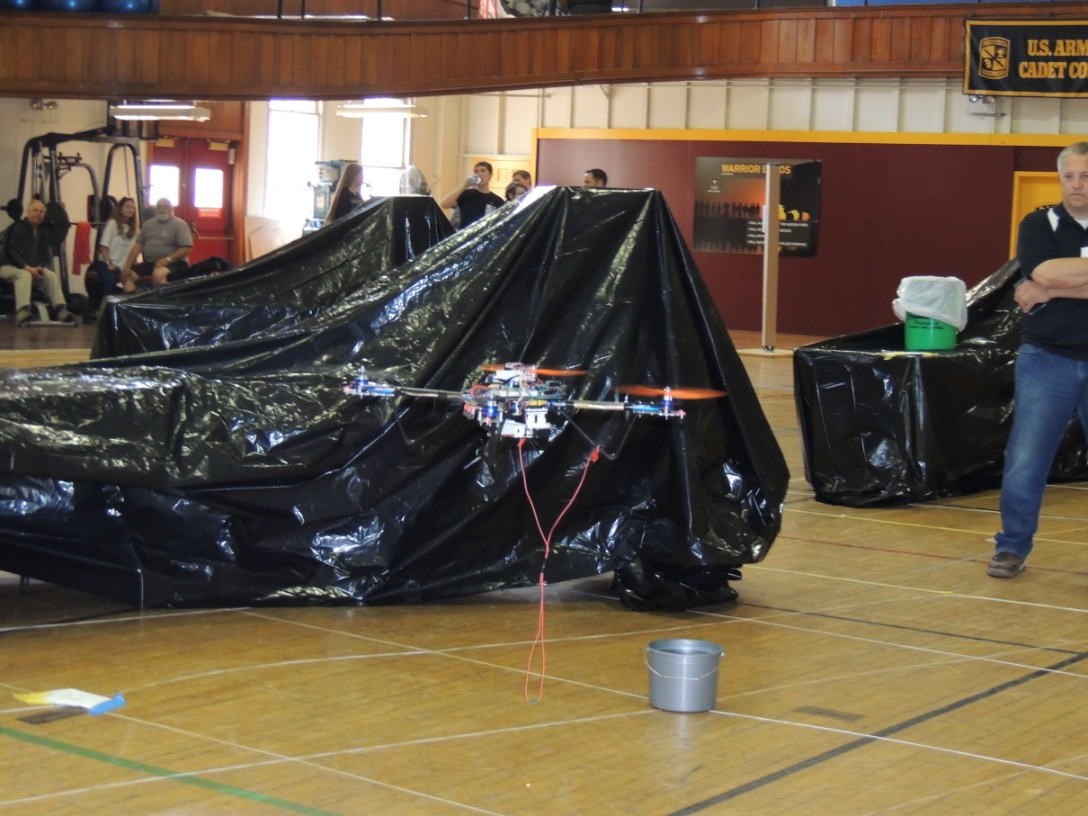
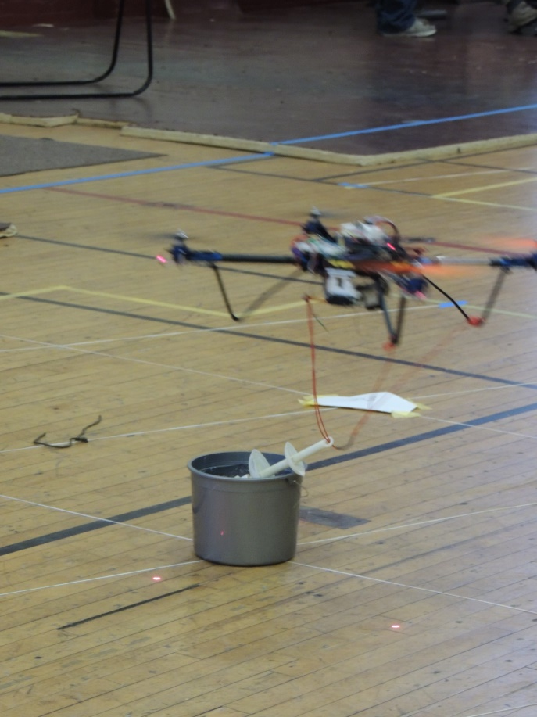
NASA’s MN Space Grant Consortium (MnSGC) Community College Quadcopter Competition
Photos from the Year 1 Competition Event

Slide 21
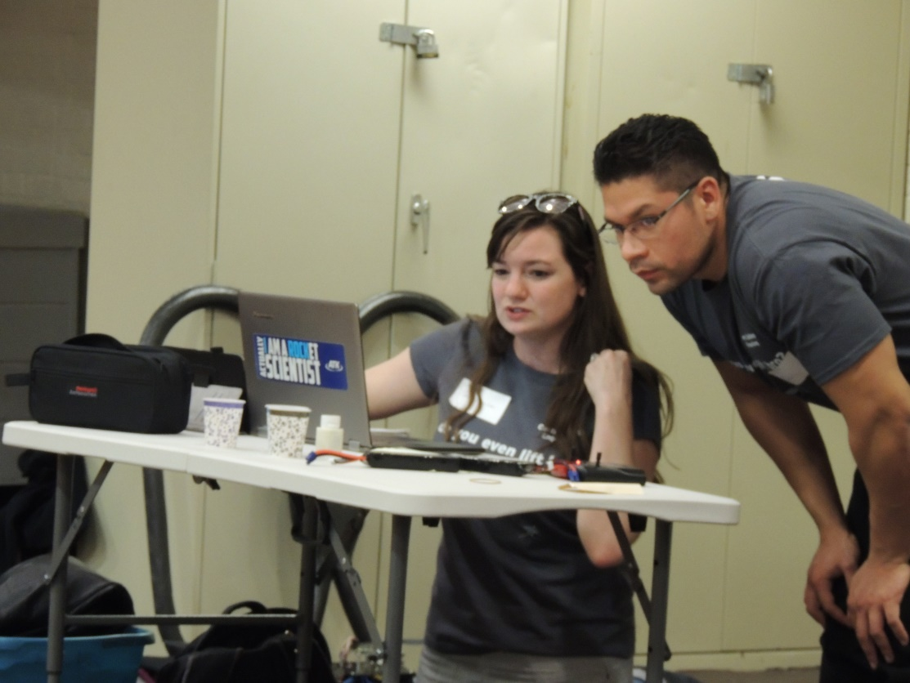
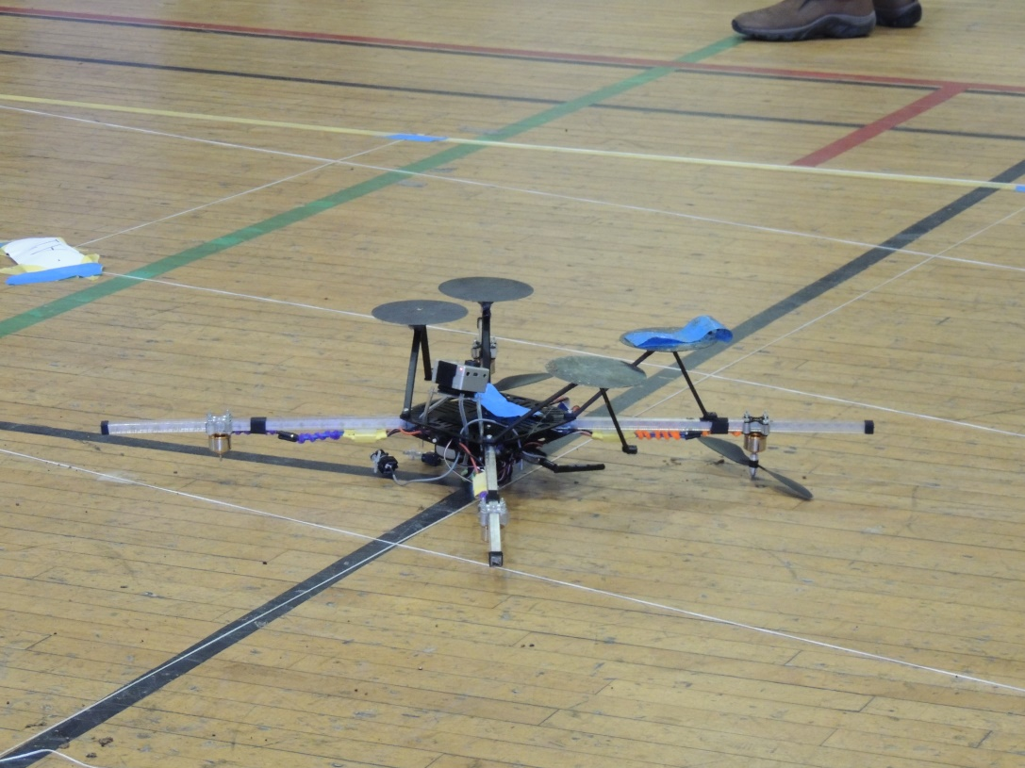
NASA’s MN Space Grant Consortium (MnSGC) Community College Quadcopter Competition
Photos from the Year 1 Competition Event

Slide 22
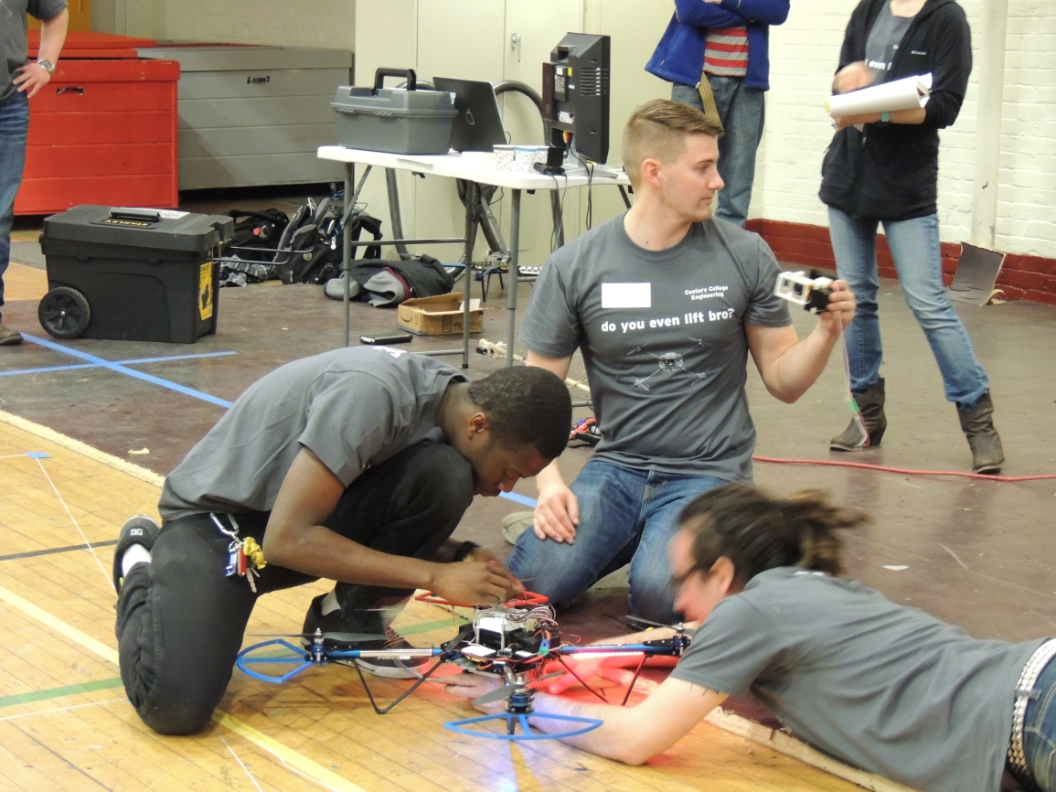
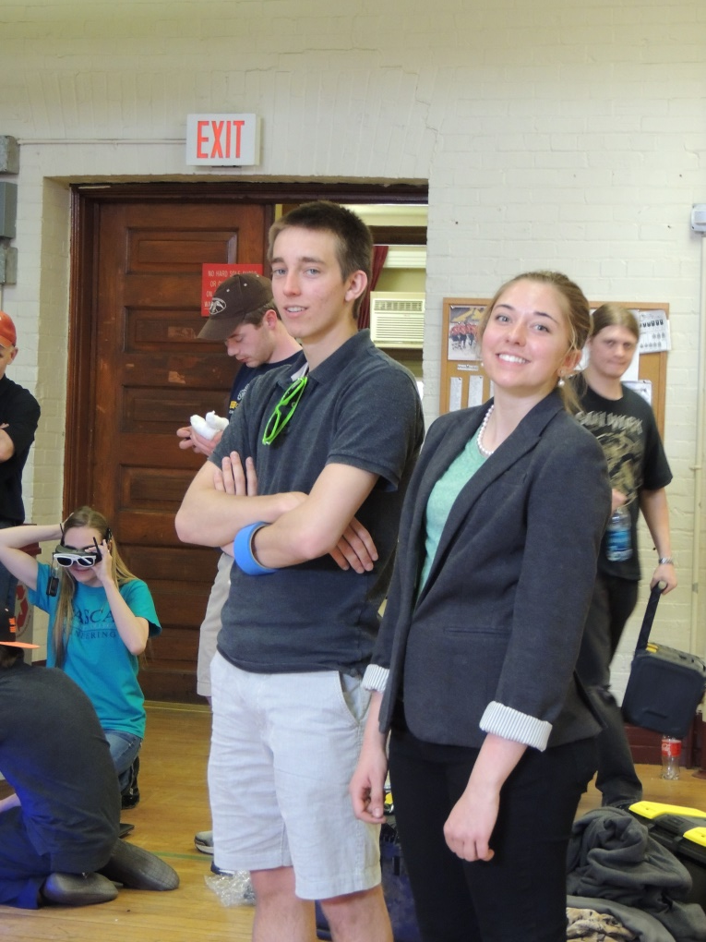
NASA’s MN Space Grant Consortium (MnSGC) Community College Quadcopter Competition
Photos from the Year 1 Competition Event

Slide 23
NASA’s MN Space Grant Consortium (MnSGC) Community College Quadcopter Competition
Testimonials (too many to share)
One student comment: I particularly enjoyed working on a project with so many potential real-world applications; brainstorming and implementing ideas for the unique capabilities and exploration was one of my favorite parts of the process. Acting as project manager really pushed me outside of my comfort zone, strengthening my leadership and organizational skills.
One adviser comment: This project has opened doors to areas that I had not considered related to my field, and I learned quite a bit about quadcopters. I was able to see first hand some of the difficulties our institution has in recruiting for STEM areas. Making connections with faculty from other institutions was really beneficial, as was connecting with UM and Space Grant. I also became more familiar with our institutional practices/procedures with grants. Overall, I have developed professionally from the experience.

Slide 24
NASA’s MN Space Grant Consortium (MnSGC) Community College Quadcopter Competition
Results from Year 1
Overall the program was very successful. Nearly all aspects were implemented as planned and on schedule.
All 7 teams built quadcopter kits, made progress on modifying them, and attended the spring fly-off in April 2015.
33 or the original 35 students on the team completed the program and achieved “significant engagement” status.
The throughput diversity was 42% women and 18% under-represented students, very close to our original targets.
17 participants graduated and all but 4 are still in STEM. 13+3 transferred to 4-year schools in STEM. All those who haven’t yet graduated continue with their STEM studies.
All advisers reported increased ability to deliver aerospace-related content in their teaching.

Slide 25
NASA’s MN Space Grant Consortium (MnSGC) Community College Quadcopter Competition
Challenges from Year 1
We didn’t have much quadcopter experience going in and neither did any of the community college advisers - we all learned a lot and expect Year 2 to go even more smoothly
The community colleges varied widely in their ability to field diverse student teams and advise them for this competition
4 out of 5 community colleges are not part of the MnSGC and some weren’t used to dealing with subcontracts
Community college students are busy – many have off-campus jobs – so some teams struggled to find times to meet and work and some students weren’t able to attend the all-team events (a few even missed the competition!)

Slide 26
NASA’s MN Space Grant Consortium (MnSGC) Community College Quadcopter Competition
Modifications for Year 2
Call it a “challenge” instead of a “competition”
Announce both “basic” and “bonus” goals to challenge all teams
Switch to a more-capable flight controller board
Push deadlines earlier to encourage faster progress
Require video documentation of flying ability and unique features, for example, to ease time pressure at the fly-off
Have the teams conduct a walk-through of the course with a functioning vehicle to ensure they have at least some realistic data to analyze for their final report even if their flying doesn’t go as planned

Slide 27
NASA’s MN Space Grant Consortium (MnSGC) Community College Quadcopter Competition
Ideas for Sustainability
All current advisers are interested in keeping quadcopter activity going on their own campuses, and hopefully as an intercollegiate event, beyond our original 2-year funding and are willing to serve as mentors to other schools that might like to join
Current schools are inviting administrators and potential future funders to attend Year 2 events, including the spring fly-off. Individual schools might be able to raise their own funds to keep it going (probably at a reduced $ level).
The MnSGC at the U of MN – Twin Cities has tentatively agreed to continue hosting and intercollegiate spring event, though will probably back off in training/mentoring.

Slide 28
NASA’s MN Space Grant Consortium (MnSGC) Community College Quadcopter Competition
Invitation
If you’d like to learn more about this effort, check out http://www.aem.umn.edu/msgc/MN_Space_Grant_Quadcopter_Challenge_2015_2016/ and/or feel free to contact the MnSGC.
This year’s competition/challenge is tentatively scheduled for Saturday, April 16, 2016 – you are welcome to attend!

Slide 29
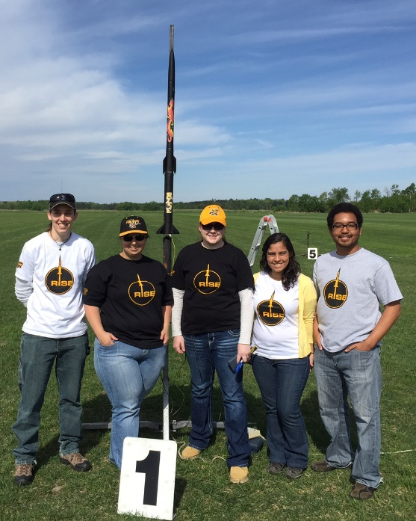
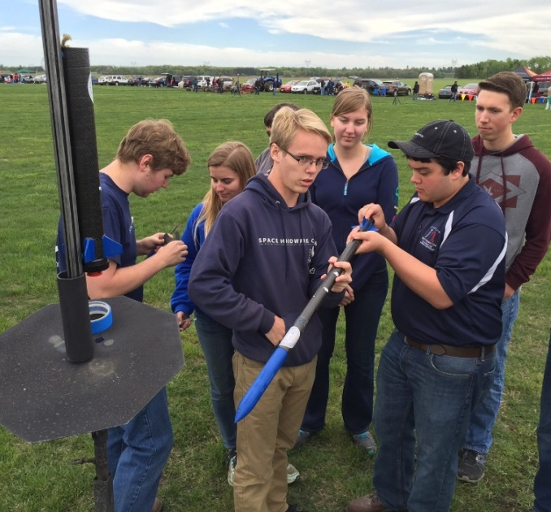
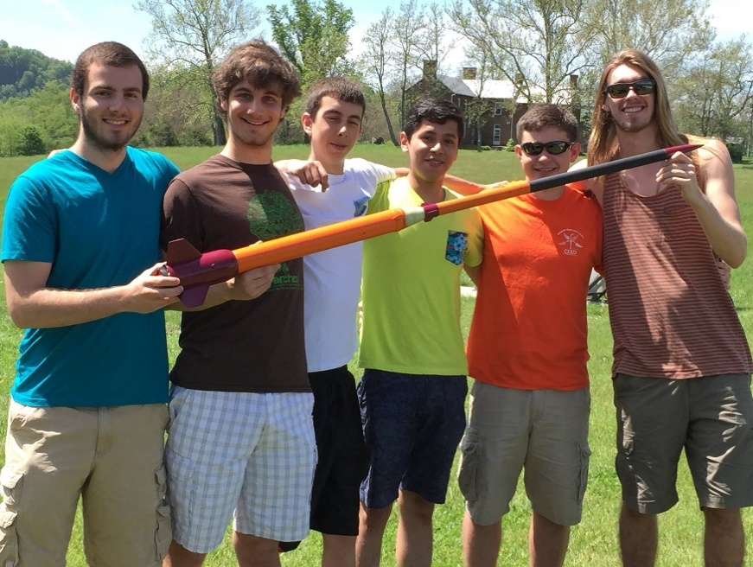
Invitation
Consider participating in the 2015-2016 Space Grant Midwest High-Power Rocketry Competition – The “Active Drag Challenge”
Learn more at http://www.aem.umn.edu/mnsgc/Space_Grant_Midwest_Rocketry_Competition_2015_2016
Sign up now (or very soon).
Competition in MN on May 15-16, 2016.
Notes:
UMD (not pictured) took first place. Team Air Mail from Hunstville (left) took second place. The Slinging Slashers from Virginia Tech (middle) too third place. Team RISE from Wichita State (right) tied for the coolest-looking rocket.

Slide 30
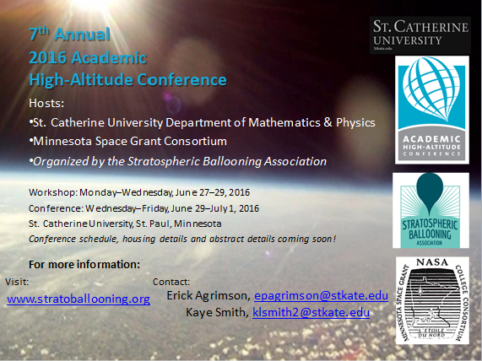
Invitation
Consider attending AHAC 2016 (Academic High-Altitude (Ballooning) Conference) on June 29 – July 1, 2016 (with pre-conference workshop days) in MN.

Slide 31
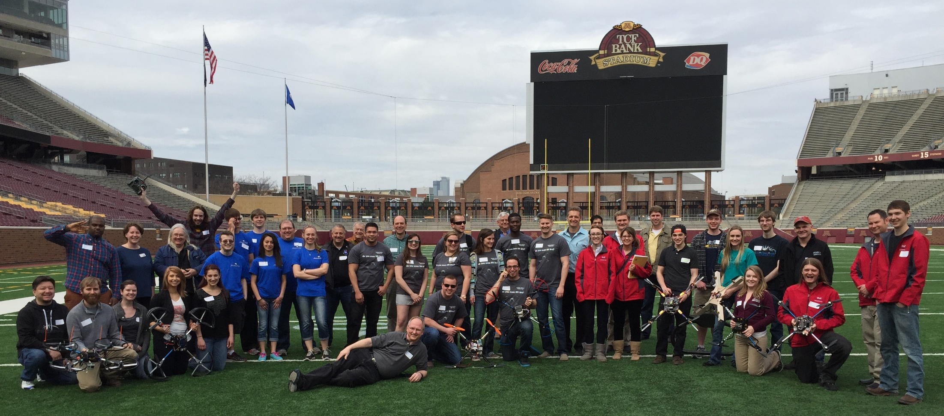
NASA’s MN Space Grant Consortium (MnSGC) Community College Quadcopter Competition
Questions / Discussion

