Slide 1
MnSGC Quadcopter Competition Photos of a Sample Exploration Area
James Flaten
MN Space Grant Consortium
University of Minnesota

Slide 2
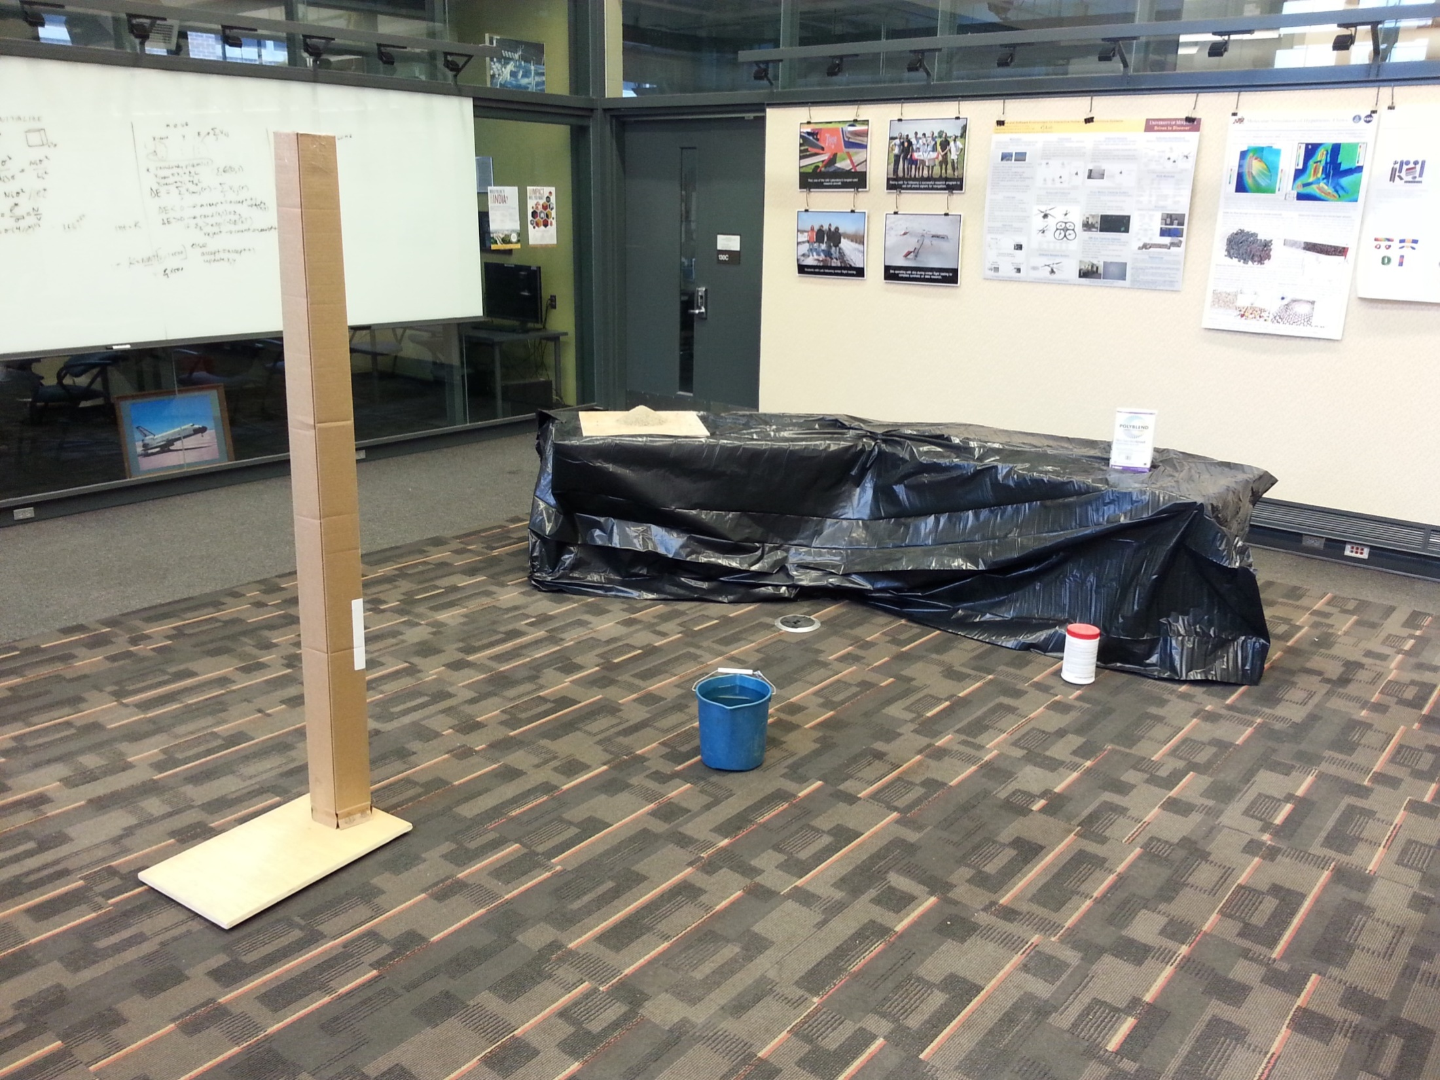
Sample area (not the same size as the real one will be) with a
variety of features and targets. Notice that the repetitive pattern
on the floor, once characterized, might help in scaling maps.
Determine size, including height, of background “mountain
feature”. Also measure ambient conditions for the whole region.

Slide 3
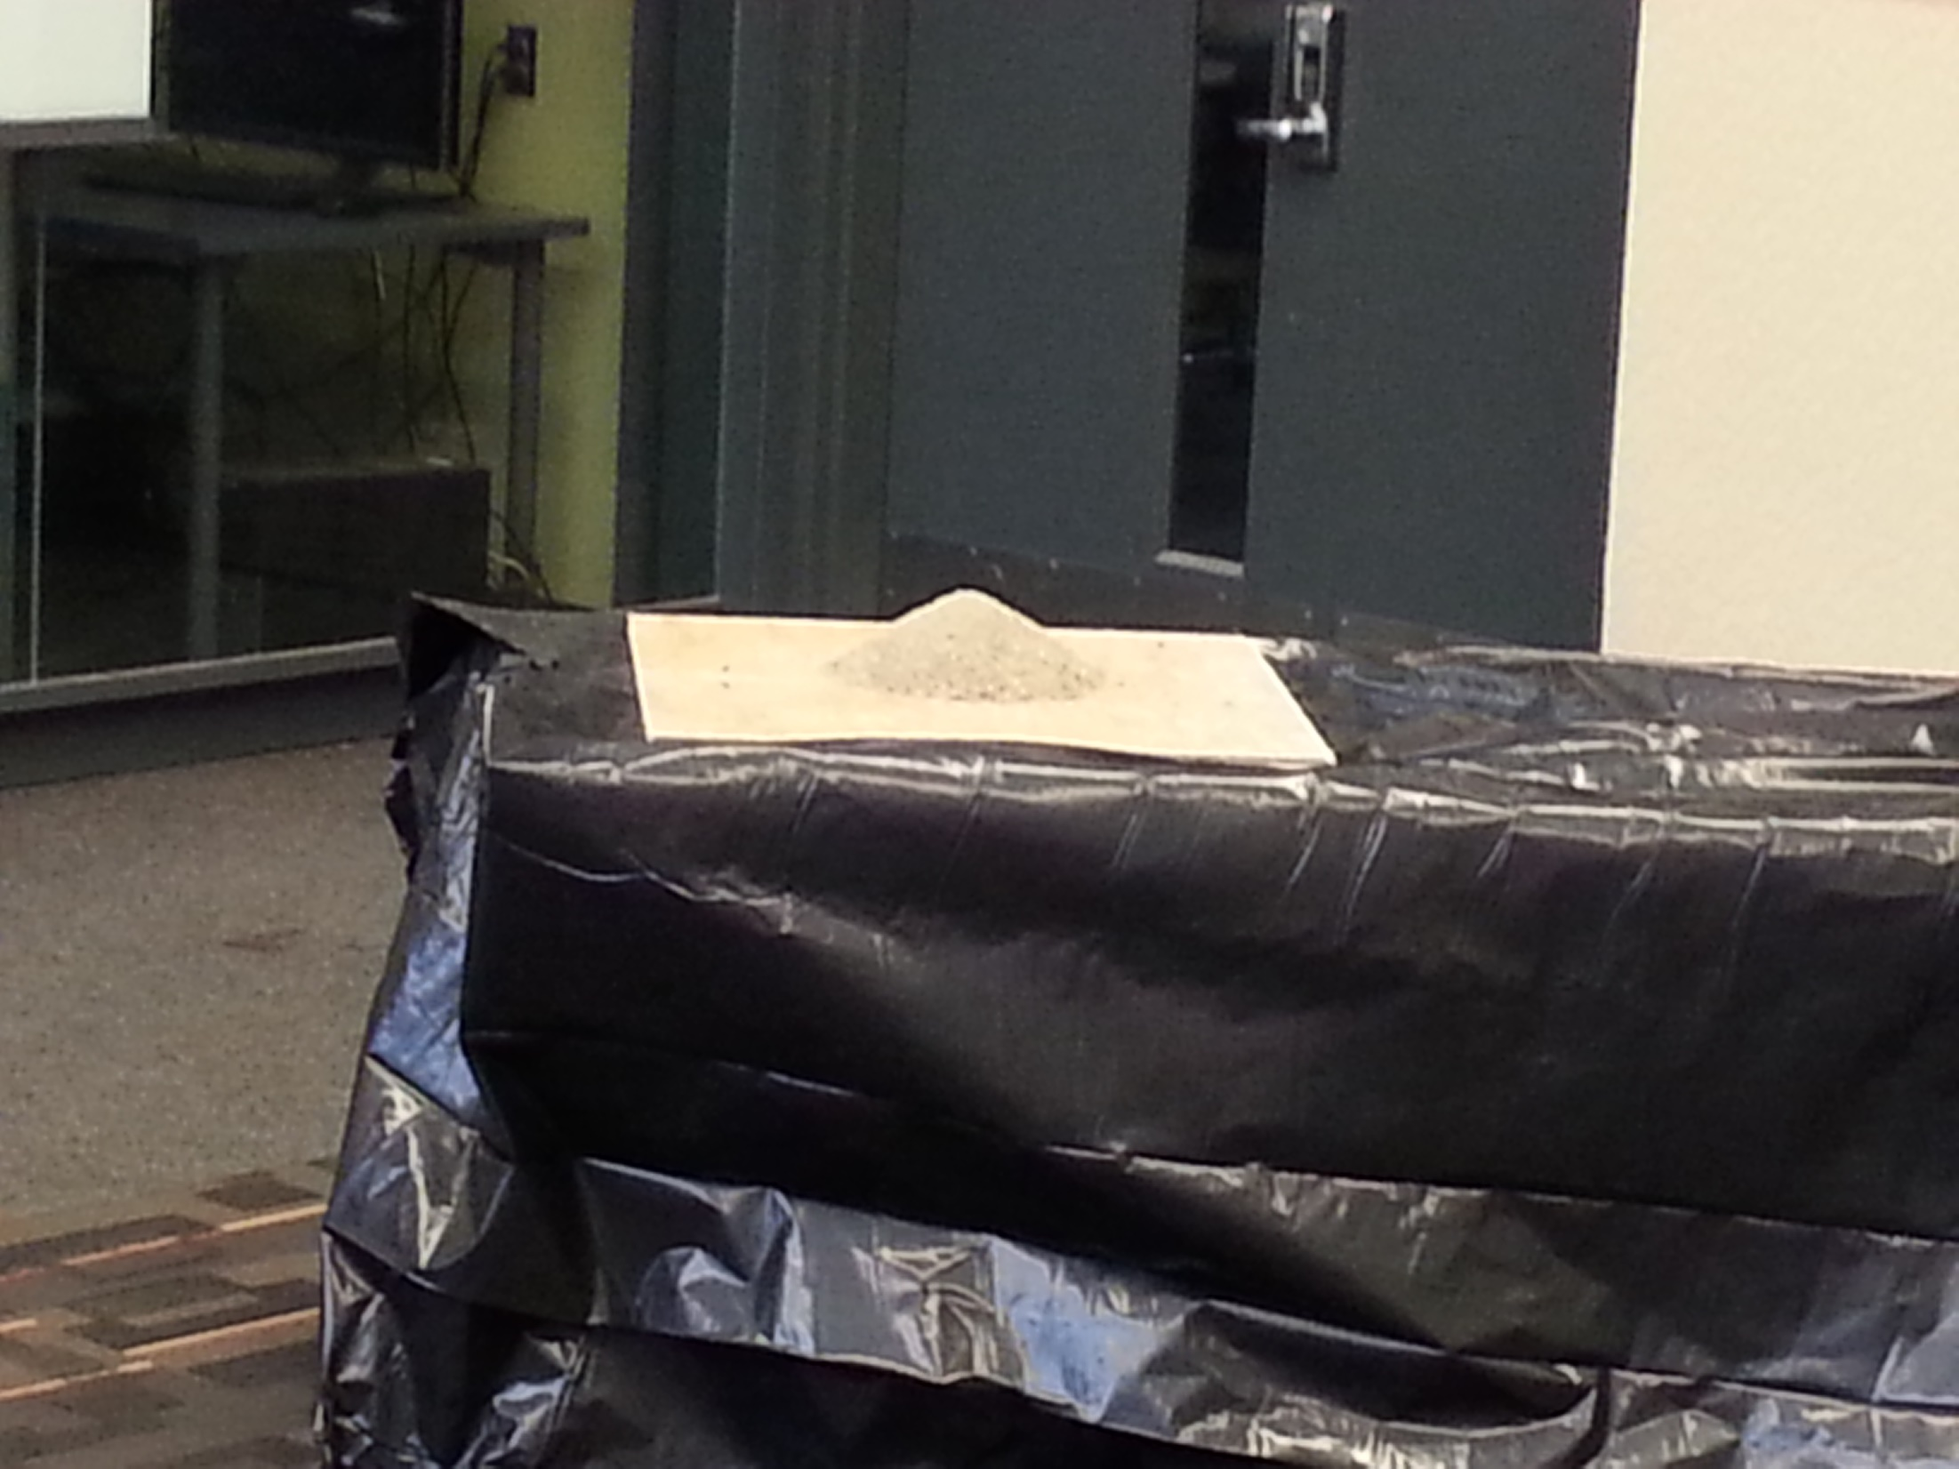
“Granular feature” – try to collect at least a 1 cubic cm sample.
Also check for potential differences from ambient conditions.

Slide 4
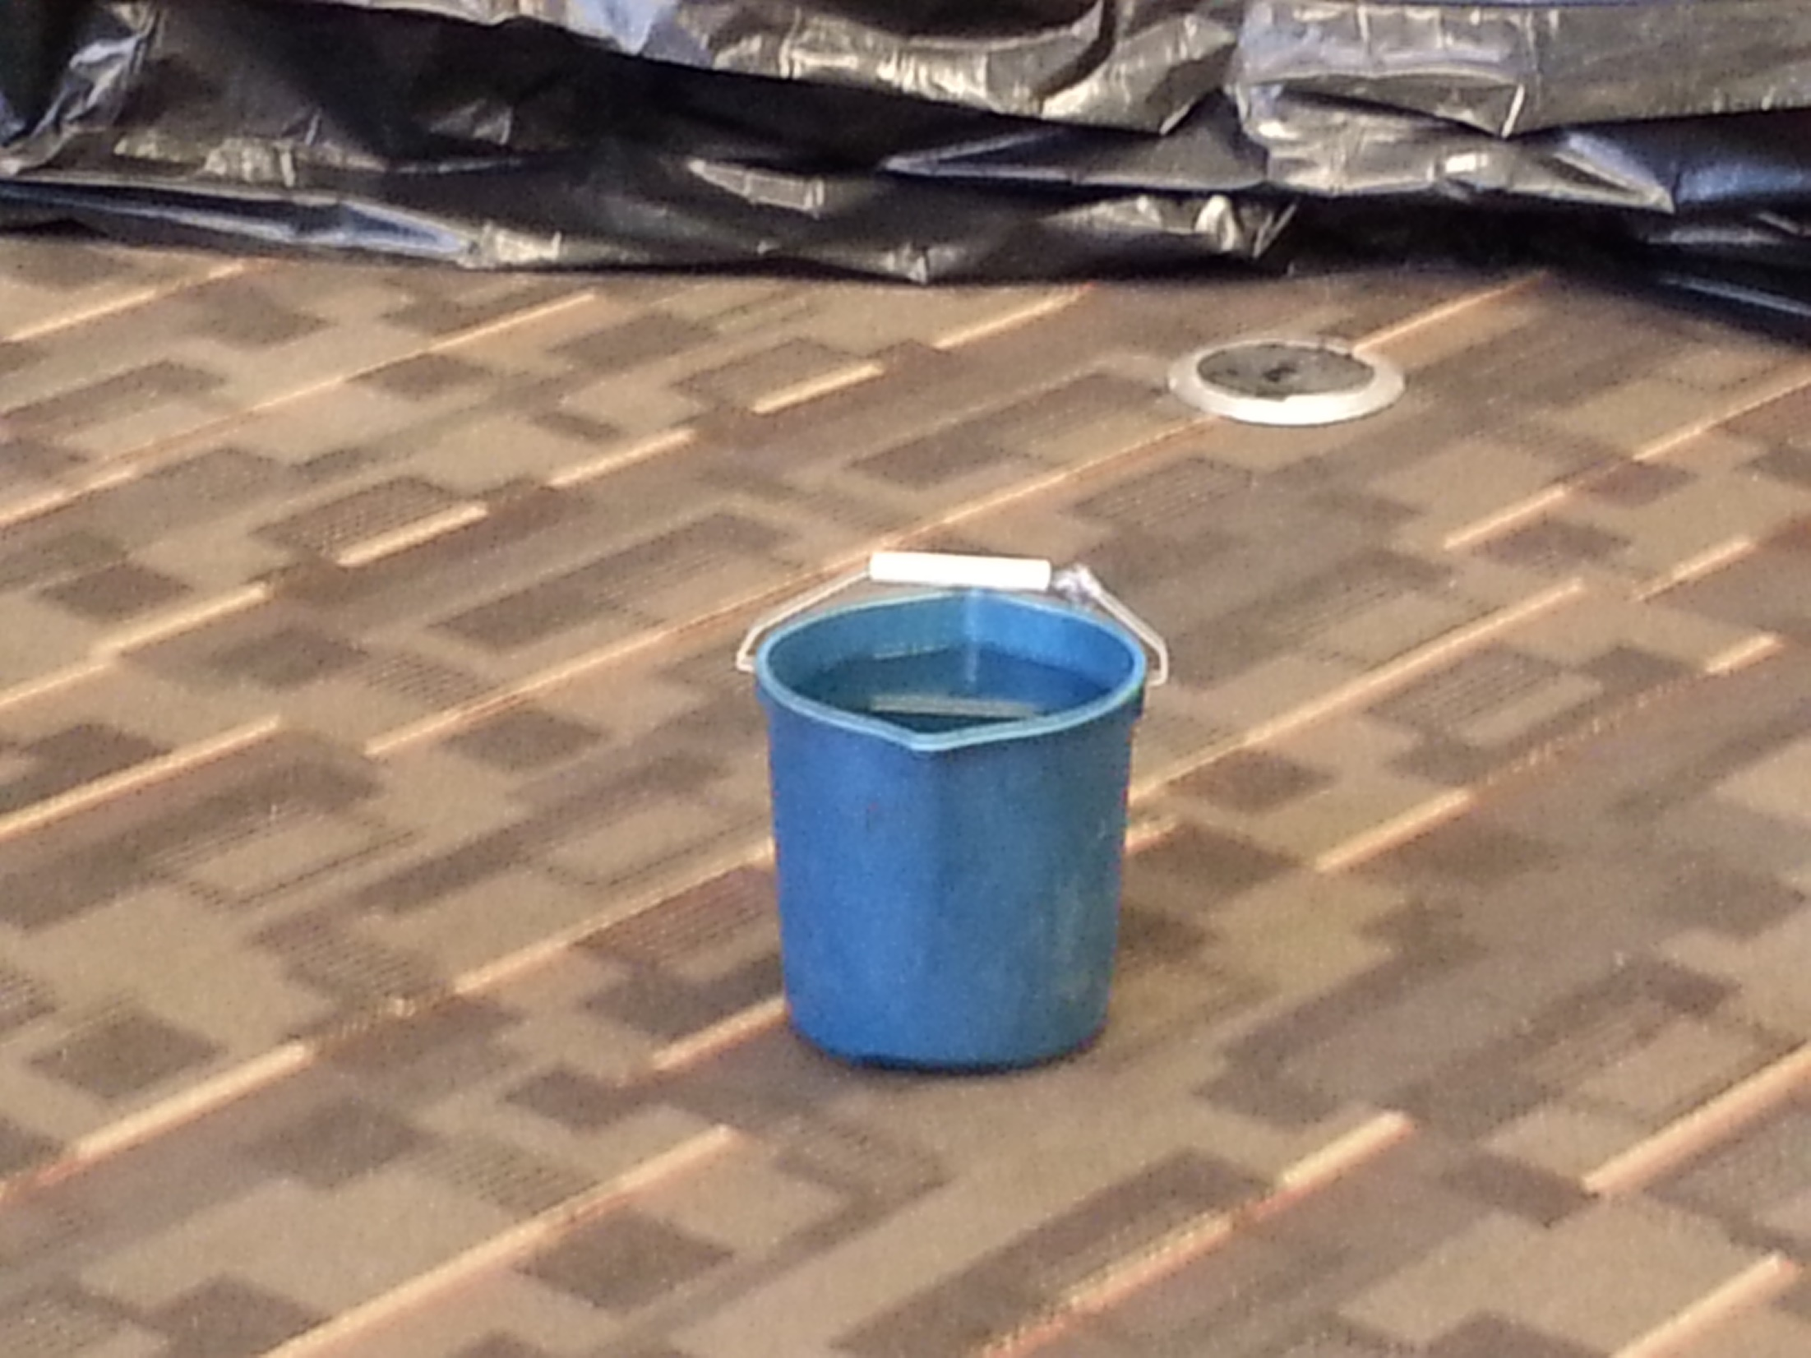
“Fluid feature” – try to collect at least a 1 cubic cm sample.
Also check for potential differences from ambient conditions.

Slide 5
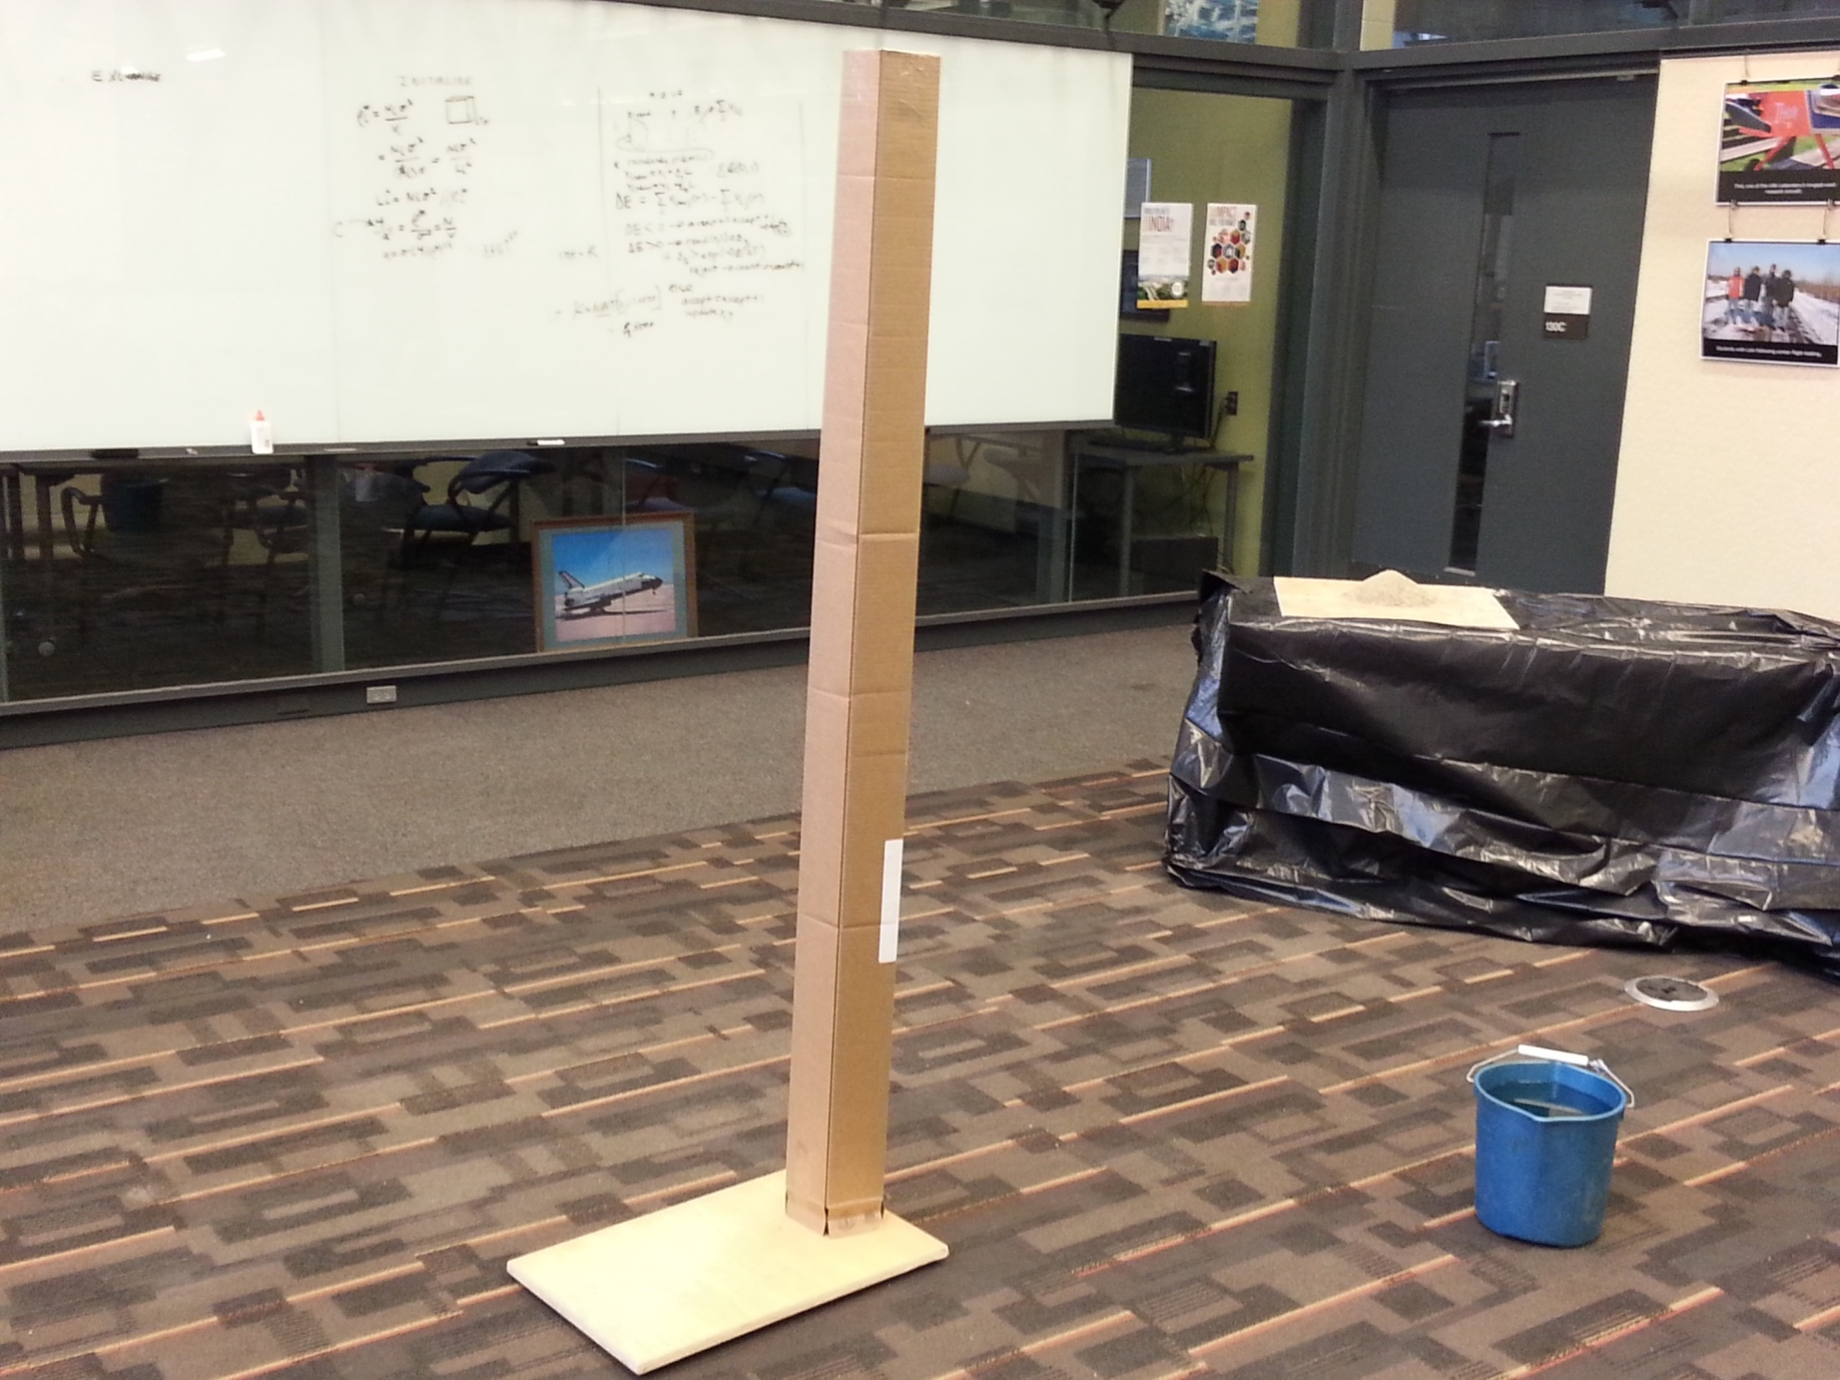
“Tower feature” – characterize its dimensions, including height.
Potential close-up imaging targets on the top or back side.

Slide 6
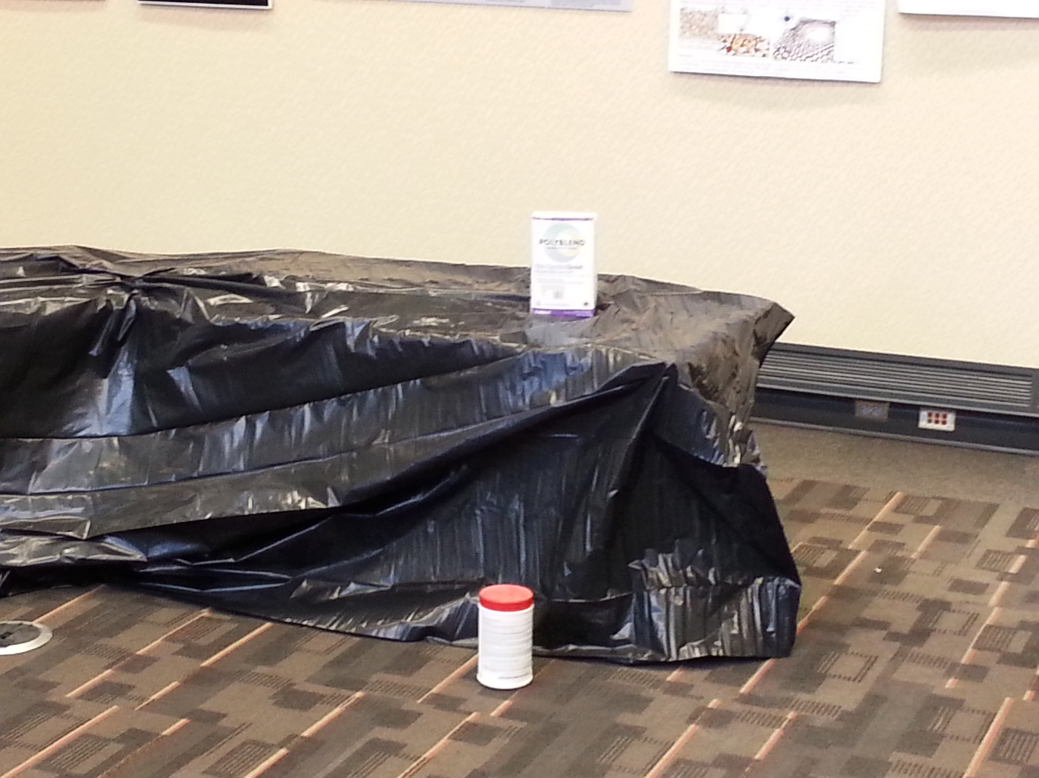
Two additional generic targets All anomalies will be located within
well-defined targets, so you can focus your exploration on them.

