Slide 1
NASA’s MN Space Grant Consortium (MnSGC) Community College Quadcopter Challenge
Participating Institutions
Central Lakes College, Brainerd & Staples campuses (1 team)
Century College, White Bear Lake (2 teams)
Fond du Lac Tribal and Community College, Cloquet (2 teams)
Itasca Community College, Grand Rapids (1 team)
MN West Community and Technical College, Worthington campus (1 team)
MnSGC / U of MN Contacts
Professor James Flaten, MnSGC Associate Director, U of MN Aerospace Engineering Department, flate001@umn.edu
TA: CJ Koshoil, U of MN 2nd-year student, koshi0190@umn.edu
TA: Noah Germolus, U of MN 2nd-year student, germo006@umn.edu

Slide 2
NASA’s MN Space Grant Consortium (MnSGC) Community College Quadcopter Challenge
Underlying goals of the program
(STEM stands for “Science, Technology, Engineering, & Mathematics”
Increase the number of community college students who graduate with STEM degrees and get jobs in STEM areas or transfer to STEM programs at four-year institutions
Increase the ability of community college faculty members to deliver aerospace-related content in areas of interest to NASA
Enhance the diversity of students pursing STEM education at Minne-sota community colleges.
The bottom line
We hope that in this program you will learn lots, have fun, and be even more motivated to stay in STEM after completing your current course of studies, going into to a STEM job or else further studies in a STEM area.
Work with us, and with your team, to go even farther in STEM!

Slide 3
Overview of how the Quadcopter Challenge will work
Fall semester
Pre-program survey
Attend “Kick-off” (training)
Learn to solder
Learn to use CAD software
Learn to program Arduino microcontrollers
Learn about 3D printing / laser cutting
Build an ELEV-8 quadcopter kit
Design, CAD, build, install rotor protection on ELEV-8
Learn to fly quadcopters using toys, simulation software, commercial quads, etc.
Design modifications to accomplish challenge goals
Write Preliminary Design Review (PDR): covers the ELEV-8 build, preliminary plans for accomplishing the challenge goals
Fall “Educational Enhancement” event
Spring semester
Implement and test modifications to accomplish challenge goals
“Mid-program” in-person interviews (assessment) with Professor Flaten, MnSGC
Spring “Educational Enhancement” event
“On-campus” and “off-campus” outreach event (at least one of each)
Write Critical Design Review(CDR): covers new designs, ELEV-8 modifications and testing
Demonstrate quadcopter capabilities at challenge event in April 2016
Oral Flight-Readiness Review(FRR): present modified ELEV-8, discuss design & test results
Write Post-competition Final Report: present competition results (e.g. maps, sensor data, etc.)
Post-program survey
NASA longitudinal tracking through “first step” (beyond current institution)

Slide 4
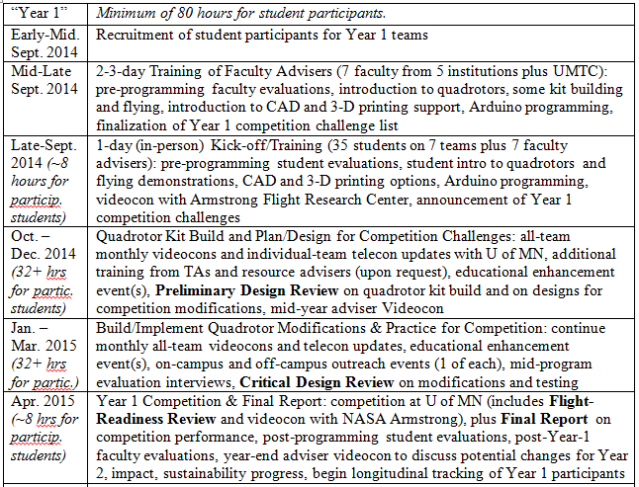
Competition/Challenge Timeline
(generic, as described in the original proposal)

Slide 5
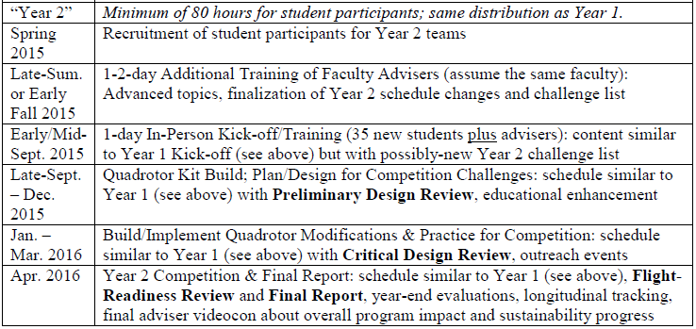
Competition/Challenge Timeline contd.
(generic, as described in the original proposal)

Slide 6
Judged Aspects of the Quadcopter Challenge
(relative weights TBA)
Rotor protection: CAD-drawn (at least), required whenever flying the ELEV-8 quadcopter [BONUS – actually fabricate the rotor protection using the CAD files]
Videos: 1-2 minutes long each – the last two (at least) will need captions and/or voice-audio
Show the ELEV-8 build and (hopefully) a demonstration flight (with rotor protection!)
Demonstration of basic piloting skills of all team members (1 minute per person maximum)
Demonstration of team’s unique capability - allowed to (but not required to) be useful during the challenge event, must involve hardware that flies on the ELEV-8, may be swapped-out equipment (i.e. it doesn’t have to be permanently mounted on the ELEV-8)
Promotional & educational video (to be posted on YouTube and peer-rated at the April event)
Written Reports: templates will be provided listing topics to cover
PDR (Preliminary Design Review) about the ELEV-8 (and rotor protection) build and preliminary plans to accomplish the challenge goals
CDR (Critial Design Review) about all modifications to the ELEV-8 (including the 3-D printed camera mount) and plans for operations during the challenge event and data analysis
PCR (Post-Competition Report) with presentation of (analyzed) sensor data, images, and maps from the challenge event
Oral Report (to judge panel at challenge event): a template will be provided listing topics to cover
FRR (Flight Readiness Review) about the ELEV-8 build, modifications, testing, and preparations for the competition event

Slide 7
Judged Aspects of the Quadcopter Challenge
(relative weights TBA)
Camera mount: CAD-drawn, must be fabricated using 3-D printing and/or laser cutting, must be switchable between out view & down view within 60 seconds, may not use velcro or tape [BONUS – continuously adjustable angle and/or can be re-aimed remotely (i.e. while in flight)]
Arduino-logged sensor pack: log air temperature, air pressure, relative humidity, and ambient magnetic field to an SD card with real-time clock stamps on all data; also be able to measure temperature and magnetic field of surface samples to identify environmental anomalies
[BONUS – send data (or perhaps just some of it) back to team in real time (i.e. while in flight)
Unique (flight hardware) feature: does not have to be useful for accomplishing challenge goals, must be different from BONUS options in other categories, must be non-trivial
Challenge event activities (walk-through then in-flight with modified ELEV-8) (may swap out equipment between challenges) (some/all will be time-limited):
Close-up imaging: take high-quality images of targets on both horizontal and vertical surfaces
General characterization and mapping of an “exploration region”: take photos and/or video, log environmental conditions using sensors, ultimately generate 3-D map(s) (i.e. include elevation variation) with real units
Characterize ground targets: probe (temperature, magnetic field) and sample return material from fluid targets (e.g. water) plus dry or wet granular targets (e.g. sand, soil, gravel)
Mystery challenge (no walk-through – flight only): announced on the spot, will involve flying, will involve teamwork

Slide 8
“Year 2” tentative program dates
Aug. 21-22, 2015: Adviser training at Fond du Lac Tribal and Comm. College
Monday, Sept. 21, 2015: All-team “Kick-off” training at Century College
Monthly all-team telecons (dates and times TBA)
Bi-weekly individual-team telecons (with slides) with U of MN (dates TBA)
All-team videocon with NASA Armstrong Research Center (date TBA)
Friday, Nov. 20, 2015: ELEV-8 build and (hopefully) demo flight video due
Fall enhancement activity(ies) (select date(s) yourself)
Tuesday, Dec. 1, 2015: Preliminary Design Review (PDR) due
Mid-program site visit and interviews (Dec. 2015 through Feb. 2016 (negotiate with Prof. Flaten), dates TBA)
Spring enhancement activity(ies) (select date(s) yourself)
Tuesday, March 15, 2016: Piloting demonstration video due
Spring outreach activities (select date(s) yourself; no later than CDR due date)
Thursday, March 31, 2016: Critical Design Review (CDR) due

Slide 9
“Year 2” tentative program dates contd.
Friday, April 8, 2016: Unique capability video due
Friday, April 8, 2016: Educational / promotional video due
Friday evening plus Saturday, April 15-16, 2016 (dates tentative): Challenge Event in the Twin Cities (location TBA)
Includes oral Flight Readiness Review
Includes peer-review of team promotional videos
Includes demonstrating hardware, imaging, exploration walk-through and fly-through doing sensor and mapping data collection, etc.
Friday, April 29, 2016: Final Report due & Post-Program Surveys

Slide 10
NASA’s MN Space Grant Consortium (MnSGC) Community College Quadcopter Challenge
Questions / Discussion

