Slide 1
Introduction to Arduino (programming, wiring, and more!)
James Flaten, MN Space Grant Consortium
with Noah Germolus, CJ Koshoil, et al.
University of MN – Twin Cities
Aerospace Engineering and Mechanics Department
Some references we used (there are many):
1. Beginning Arduino by Michael McRoberts, 2nd edition
2. http://www.arduinoclassroom.com/index.php/arduino-101
3. http://www.oomlout.com/a/products/ardx/

Slide 2
Goals of this lesson
Learn what microcontrollers are and things they can do.
Learn how to use a (solderless) breadboard to wire up sensors and other hardware to an Arduino Uno.
Learn to open, understand, comment, upload/run, and edit Arduino programs (AKA sketches).
Learn the difference between input, output, and power pins and also between analog and digital pins.
Learn to control things like LEDs and write information to the serial monitor (a text window on the computer).
Learn to read sensor values and log data to an SD card for later retrieval and analysis.
Learn the basics of using motors
Learn to expand Arduino functionality with “shields.”
Put you in a position to implement an Arduino-based computer system for your own projects.

Slide 3
What is a Microcontroller?
“A microcontroller is a very small computer that has digital electronic devices (peripherals) built into it that helps it control things. These peripherals allow it to sense the world around it and drive the actions of external devices.” (Ref. 2)
It is an “embedded computer system” that continuously repeats software (programming) commands
Examples: Arduino Uno, Raspberry Pi, etc.

Slide 4
Arduino Uno
Digital
(Input/Output) Pins
USB Connector
Battery Connector
Analog
(Input) Pins
Power Pins

Slide 5
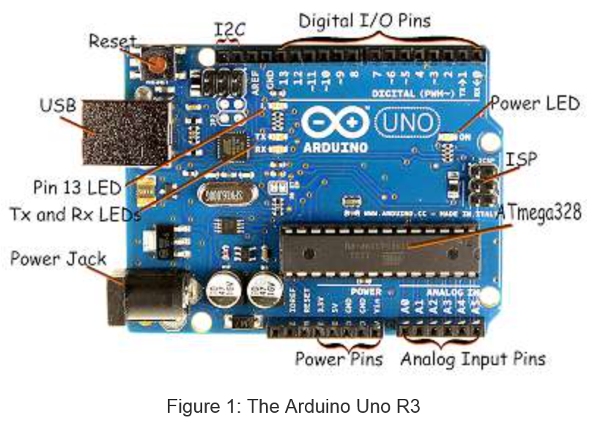
Arduino Uno – more details (Ref. 2)

Slide 6
Arduino Mega – Larger, more pins (we won’t be using this today)
USB Connector
Serial Pins
Digital Pins
Battery Connector
Power Pins
Analog Pins

Slide 7
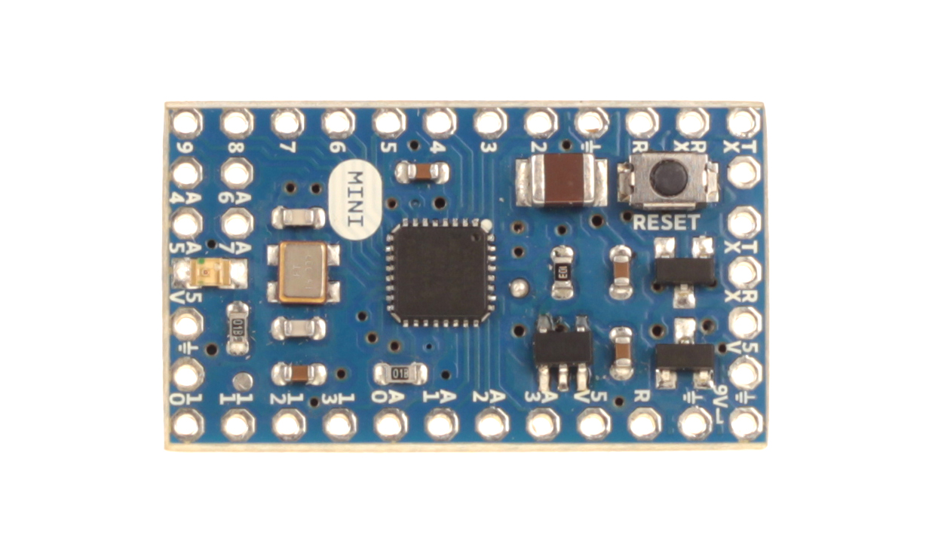
Arduino Mini – Smaller and lighter; (more appropriate for some applications)
Digital Pins
Serial Connectors
Analog Pins
Power Pins

Slide 8
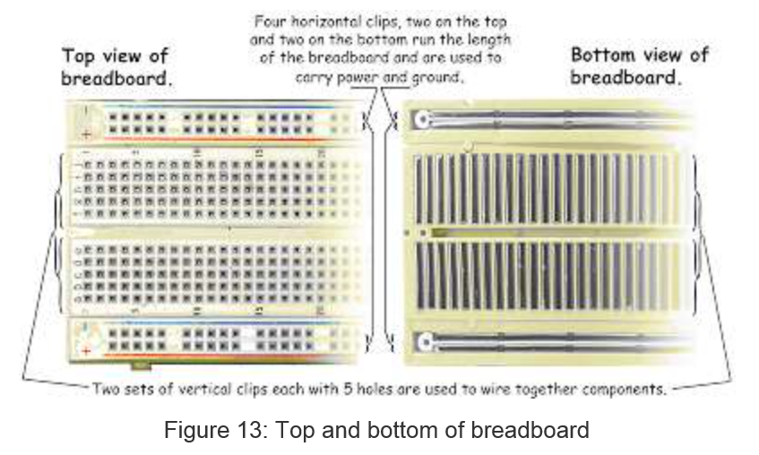
(Solderless) Breadboard (Ref. 2)

Slide 9
Breadboard Innards (Ref. 2)
Insert 22-gauge solid wire jumpers and component leads into breadboard clips to make
electrical connections without soldering. Use the edge “rails” for power (5V) and ground.

Slide 10
Introduction to Software
Arduino microcontrollers are programmed using the Arduino IDE (Integrated Development Environment)
Can be downloaded for free from http://arduino.cc/en/Main/Software
Arduino programs, called “sketches”, are written in a programming language similar to C and C++
Every sketch must have a setup() function (executed just once) followed by a loop() function (potentially executed many times); add “comments” to code to make it easier to read (technically optional, but actually required (by me))
Many sensors and other hardware devices come with prewritten software – look on-line for sample code, libraries (of functions), and tutorials

Slide 11
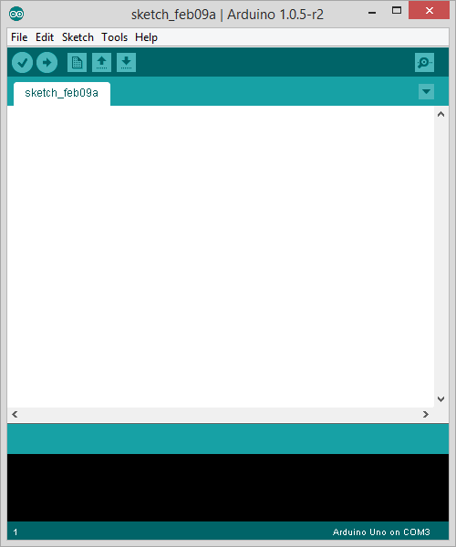
Parts of the IDE main screen
Name of current sketch
Main menus
Action buttons/icons
Verify (AKA compile)
Upload (send to Arduino)
Start a new sketch
Open a sketch (from a file)
Save current sketch (to a file)
Open Serial Monitor window
Text area for
writing/editing
sketches.
Error messages and other
feedback show up here.

Slide 12
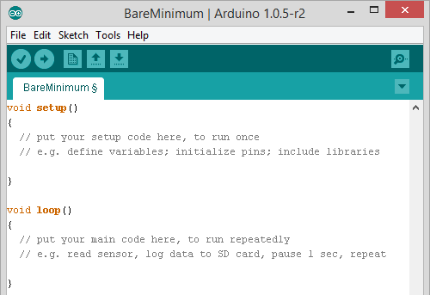
BareMinimum – sketch organization

Slide 13
Activity 1 – making an on-board and external LED blink
Place an LED on the breadboard (don’t put both legs into a single (connected) column)
Wire the LED’s negative (shorter) lead to a 560 Ohm “safety resistor” then wire the other end of the resistor to ground (GND)
Wire the LED’s positive (longer) lead to digital Pin 13 on the Arduino
Plug in the Arduino with the USB cable and run the Arduino IDE software on the computer
Under Tools:Board make sure Arduino Uno is selected
Under Tools:Serial Port select the correct COM port (e.g. COM3)
Under File:Examples:01Basics select the Blink sketch
Look at the code. Note delay(1000) waits 1000 millisec = 1 second
Verify (AKA Compile) the code , then Upload it to the Uno – notice that it runs immediately (and will re-run if you power cycle) – the sketch will stay in the Uno memory until overwritten or erased
Discuss how the sketch works (in general terms: setup(), loop(), liberal use of comments); digital HIGH is 5V and LOW is 0V (ground)
This is an example of “control (output) using digital pin 13”

Slide 14
About Motors
There are several different types
Standard DC motor - input current for full continuous rotation. No special pins or wiring.
Standard servomotor (AKA servos) - Motor capable of limited rotation (generally 180°) in precise degree increments. Uses Servo library in Arduino. Have 3+ pins. Controlled by pulse-width modulation (“~” pins)
Continuous rotation servo – can go all the way around continuously. Interprets PWM value as speed & dir.
Stepper Motors - Servo capable of full rotation in small steps. Uses Stepper library in Arduino. Have 3+ pins
We are using a standard servo in this lesson.

Slide 15
Activity 2: Using a Servo
With the Arduino Uno unplugged, wire up the servo according to the chart on the next slide
Load the sketch Servo.ino
Take a look at the code and note the commands used to drive the servo. The comments should help you understand what each does.
Be careful – Some servos use a lot of power and may need an external power source.
Notes:
Servos use the library Servo.h
Only a few simple commands: attach, read, write
Our servos only go 180°
Can modify to spin 360°(Have to disassemble the motor and modify gears, not that easy)
Often better to use a stepper motor for full rotation
Can have it go specific degree increments
Disables analogWrite() on pins 9 and 10

Slide 16
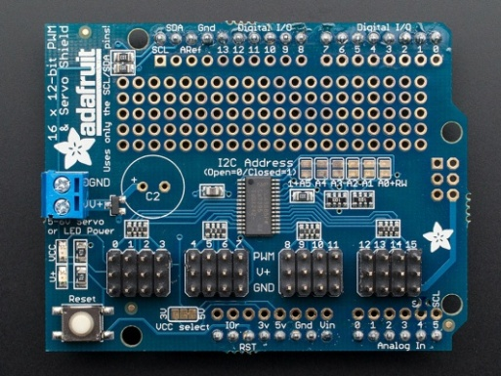
Servo
Pin | Description | Attached To
Brown | Ground | GND
Red | Power (5V) | 5V
Orange | Control Lead | D3
Note that the servo has a plug attached to its ribbon cable. This is so that we can more easily extend the cable using plugs and more ribbon cable. It also allows it to plug into specific plugs built into some shields. Several companies make a few different Motor Shields, which are shields specifically designed to drive servos, motors, and stepper motors. These usually support 2 to 4 motors, although Adafruit has one that will control 16. They generally have plugs built into the shield for the motors and often drive them through some sort of a serial connection (I2C or SPI is common).
Right: Adafruit Motor Shield
http://www.adafruit.com/products/1411

Slide 17
To Sweep or Not to Sweep
In many applications it might not be necessary to use a “sweep” sketch, where the servo sweeps between angles in incremental small steps.
Another way may be to set the servo to just “open” (go to one angle) and “close” (go to another angle). This might be easier to code than “sweep.”

Slide 18
Notes about Libraries:
Libraries take large amounts of code and refine it into a few simple commands we can use. Ex: datalog.print will print something to a file.
This actually takes a lot of code, but by putting it in a library we can ignore the basic code and focus on the useful commands and functions
Usually ends in a .h (header file)
Used in our programs by the #include command: #include "SD.h"
Almost everything that is not analog (digital sensors, servos, etc) use a library of some sorts (Many use the same library - i.e. Wire)
You can install more libraries into your IDE. Look under Sketch:Import Library to see which ones you have.
Ex. SD.h, SoftwareSerial.h, Wire.h, OneWire.h, RTClib.h

Slide 19
Proto shield & “tiny” breadboard
We are not using the proto shield today, but they can be seen in your kit.
Notice that this “tiny” solderless breadboard (ours are white) has no power rails and very limited real-estate. Use it wisely!

Slide 20
A few words on sensors
The rest of the lesson will focus on how to use various sensors to make measurements and how to “log” (record) those values to an SD card.
Sensors can be broken into two major categories:
Analog sensors
Based on changing the voltage of the sensor
Can only use analog inputs (Arduino pins A0, A1, etc)
Generally easier to program and use
Not as accurate & easily interfered with by other electronics (noise in voltage)
Readings can be influenced by cable length – keep connection cables short!
Digital Sensors:
Usually use digital pins
Can use more advanced forms of communication to let multiple sensors share the same pins (sometimes even using analog pins)
Generally more difficult to program and wire up; often need libraries and significantly more code for each type of sensor used
Most advanced sensors (GPS, IMU, etc) are digital – this is the best way to pass more data between sensor and microcontroller quickly & efficiently

Slide 21
About Digital Sensors:
Digital sensors used with Arduinos are powered using either 3.3 volts or 5 volts – both are available on the Arduino
Always check to be sure you are providing the correct voltage. If you send a 3.3V sensor 5V it is very easy to blow it out.
Watching for pin conflicts and voltage discrepancies is par for the course when using microcontrollers. If you aren’t careful you can get bad data, fry components, or possibly even damage the microcontroller itself.
Aside: Also watch out for components that look similar (e.g. the analog temp sensor and the digital temp sensor). And remember that most components require a specific orientations (i.e. it matters which leg gets attached to which pin); resistors and some types of capacitors are an exception and can get plugged in either way

Slide 22
Activity 3 – Wiring and logging sensor data
Shields and sensors involved:
Micro-SD or full-size-SD card shield
Data LED indicator (tells whether the SD card is logging data (steady flash) or not (multi-flash (indicating an error))
Analog temperature sensor
Digital 3-axis magnetometer sensor

Slide 23
Micro-SD or SD Shield and Data LED Indicator
Plug the micro-SD or SD shield directly onto an unpowered Arduino Uno. All the legs must go straight into the header – don’t bend any.
Wire an LED using the tiny breadboard:
- Positive (long) leg wired to a safety resistor. Other end of resistor connects to digital pin 5.
- Negative (short) leg wired to ground (GND).
(Aside – This has the resistor on the opposite leg from last time. It is important to get the orientation of the LED itself right, but not the resistor and it doesn’t matter which leg the safety resistor goes on as long as it is in series with the LED to limit current flow through the LED.

Slide 24
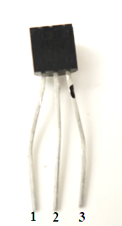
Analog Temperature Sensor
With the Arduino Uno unpowered, wire the TMP 36 sensor using the table below
Pin | Function | Attached To
1 | 5V (Power) | 5V pin
2 | Analog Output | Pin A2
3 | Ground | GND pin
This 3-pin sensor has TMP written on it. This is called a T0-92 package.
Make sure the flat side of the sensor has “TMP” written on it!
Check the orientation!
Note: The photo shows flat side facing you.

Slide 25
Digital 3-Axis Magnetometer
With the Arduino unplugged, add the Digital 3-Axis Magnetometer MAG 3110 to your breadboard using the table below:
Aside: a magnetometer can be combined with an accelerometer (and maybe gyros) to make an IMU (Inertial Measurement Unit)
Not perfect - a magnetometer can be interfered with by magnets, metals, and other electronic devices (good IMUs can account for such interference, to some degree)
Pin | Function | Attached To
VCC | Power Input (3.3V) | 3.3V
GND | Ground | GND
SDA | Serial Data Line (I2C Bus) | A4
SCL | Serial Clock Line (I2C Bus) | A5
INT | Interrupt Pin | Not Connected

Slide 26
Logging the Data
Open the sketch Temp_Mag_Log.ino
As you can see in the code setup, data logging can be a bit complex.
Most of the time you can directly copy the code from the setup loop used for the SD card
A few details to keep in mind:
Must do all reading/writing of data in the main loop.
We included a special piece of code to write a new file each time the Arduino is powered. Without this, it would overwrite our old data
Pins can change depending on the SD card reader you use. The Sparkfun Micro-SD Shield uses D8 and D10-13. The Adafruit full-size-SD-card shield uses D10, not D8, for “chip select.”

Slide 27
Datalogging (To SD Card)
Load the sketch Temp_Mag_Log.ino onto the Arduino
Open the Serial Monitor window
- Important note! The serial monitor normally operates at 9600 baud but this sketch runs it at 115200 baud so you will need to open the serial monitor and change the baud rate using the drop-down menu at the bottom right hand corner.
What is shown in the serial window? How can you verify the data recorded is being saved onto the SD card?
After you have run the Arduino for a bit, unplug it, disconnect the SD card, and read the SD card on your computer. How does the data look?

Slide 28
What is always useful…
How can you analyze raw data off the SD card? You may not remember when/where it was taken so it is useful to add a “time stamp” and/or a “GPS (location) stamp” to data as it is saved.
A RTC (real time clock) comes in certain SD shields or breakout boards – use to put a time stamp on data.
GPS can also come as a separate shield or a breakout board on its own – use to put a location stamp on data.
Again, when logging sensor data, it’s useful to tag the data to help remember exactly where it came from.

Slide 29
Notes on writing to the “Serial Monitor”
Before setup, the variable being recorded in a serial monitor or SD card is declared
In setup, the serial communications need to be started, with the baud rate (char per second) given in parentheses like this: Serial.begin(9600). When you open the serial monitor window make sure the baud rate (in the lower right hand corner) matches the baud rate called for in the sketch – pull-down to change it if need be.
At the end of the loop, the command Serial.print(); is used to print the data to the serial monitor.
Every time the serial monitor is reopened, it is “refreshed” and starts data over (e.g. if you were counting, it would always start at “1” when you open it)

Slide 30
Notes
Flashing LEDs and/or writing information to the serial monitor (window) lets the sketch tell observers what it is up to – the latter only works when you are attached to a computer with a screen, so the former method might be more useful for field/flight implementation
Digital pins can be set to OUTPUT mode, after which you can send them digital values (just HIGH or LOW) with digitalWrite or else more-continuous analog values (from 0 to 255) with analogWrite – the latter still sets them just HIGH or LOW, but does so only some fraction of the time which makes some devices think the output voltage is somewhere between HIGH (5 Volts) and LOW (0 Volts)
“fritzing” software (free download) for drawing circuits: “breadboard view” (fairly realistic) vs “circuit diagram” view (AKA “schematic”)

Slide 31
A “breadboard view” looks fairly realistic

Slide 32
A circuit diagram (AKA schematic)

Slide 33
Typical wiring of a powered analog sensor

Slide 34
Note the utility of having both 0V (AKA GND) and 5V “rails” (but “tiny” breadboards don’t have rails)

Slide 35
Next Steps
This has only been a brief intro, things can get a lot more complicated!
Look online for help with advanced projects, weird things (pin conflicts, voltage issues, software bugs, etc) can happen pretty easily
Also keep in mind how much power you are drawing- you can drain individual 9V batteries quickly- use more in parallel to provide enough current for a long run time
Research and think through projects before building. A good plan can solve many problems before they occur

Slide 36
Good further resources
https://learn.adafruit.com
Adafruit makes many shields and sensors, and they have tutorials for almost everything they carry
http://www.arduinoclassroom.com/index.php/arduino-101
Arduino Classroom is currently doing an intro series on Arduinos. Check it for updates and more topics in the future
http://playground.arduino.cc/
Arduino playground is the wiki run by the Arduino company for its products. There is a lot of helpful information on almost everything imaginable here.

Slide 37
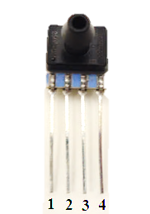
Activity 4 – analog (air-)pressure sensor
With the Arduino Uno unpowered, wire the 0-15 psi pressure sensor using the table below (you can leave the TMP 36 sensor in place)
Load the sketch Analog_Pressure; study code; run; test; discuss
Pin | Function | Attached To
1 | Nothing | Not connected
2 | 5V (Power) | 5V pin
3 | Analog Output | Pin A0
4 | Ground | GND pin
This 4-pin pressure sensor is the Honeywell SSCSANN015PAAA5 and is called a SIP-AN package.
Notes:
Note-Test by sucking on it- cannot have pressure above 15psi (We are about 14.2 psi here, so blowing on it would blow it out)

Slide 38
Activity 5 – analog relative humidity sensor
With the Arduino Uno unpowered, wire the HIH4030 relative humidity sensor using the table below (leave other sensors in place)
Load the sketch Analog_Humidity; study code; run; test; discuss
Pin | Function | Attached To
GND | Ground | GND pin
OUT | Analog Data Output | Pin A1
5V | 5V (Power) | 5V pin
This 3-pin relative humidity sensor is pre-mounted on a “breakout board”
Notice that we soldered on a 3-pin male header so the breakout board can plug into a (solderless) breadboard

Slide 39
Activity 6 – using a 3-axis accelerometer
The digital 3-axis accelerometer (breakout board ADXL345) is powered with 3.3 volts, not 5 volts, and makes use of analog pins D10-D13 for communication. All 3 outputs (the x, y, and z values) are sent through the serial data line, D11, clocked (i.e. timed) by line D13.
The digital accelerometer makes use of the SPI library which should already be in your Arduino program.
Plug in the Arduino Uno and load Digital_Accelerometer
Study the code (it might be long!); run it (open serial monitor); test all 3 axes, discuss

Slide 40
Digital 3-Axis Accelerometer (breakout board ADXL345)
Pin | Description | Attached To
GND | Ground | GND
VCC | Power input (3.3V) | 3.3V
CS | Chip Select | D10
INT 1 | Interrupt 1 Output | N/A
INT 2 | Interrupt 2 Output | N/A
SDO | Serial Data Output (SC0) | D12
SDA | Serial Data (SDA) | D11
SCL | Serial Communications Clock (SCL) | D13

Slide 41
Activity 7 – digital pressure/temp sensor
With the Arduino Uno unplugged, add the pressure (altitude) / temperature (MPL3115A2) breakout board to your tiny breadboard and wire it as follows. This is a 3.3 volt I²C device.
Look for pin conflicts. Hopefully there won’t be any (but always look).
Plug in the Arduino Uno and Altitude_Pressure_plusTemp_Sensor
Study the code (it might be long!); run it (open serial monitor); test, discuss
Pin | Description | Attached To
INT2 | Pressure interrupt 2 | Not connected
INT1 | Pressure interrupt 1 | Not connected
SDA | Serial Data | A4
SCL | Serial Communications (Clock) | A5
VCC | Power input (3.3V) | 3.3V
GND | Ground | GND

Slide 42
Activity 8 – 2 digital temp sensors, SD card
With the Arduino Uno unplugged, add one “Dallas one-wire” digital temperature sensor on the breadboard and a second one at the end of a 3-wire cable (provided), as shown on the following slide. Notice that both sensors need ground and power (5 volts) and that they are polled through a single digital pin (D2). Also notice that a 4.7 kΩ “pull-up” resistor is required between pin D2 and the 5 volt line so that it stays HIGH when not in use.
Place OneWire and DallasTemperature into your Arduino library. This activity also uses Wire and SD (already in your library).
Put an SD card into your SD card shield.
Plug in the Arduino Uno and load the sketch SD_RTC_2_Digital_Temp which will determine the sensor names, poll them, write the results to both the screen and to the SD card (after opening a file), then repeat.
Study the code (it might be long!); run it (open serial monitor); test (including removing the SD card and reading the data directly on your computer). Discuss the utility of saving data this way; discuss the utility of having “off-board” sensors. Note: cable length can impact analog sensor data readings so always minimize cable lengths and use digital sensors when off-board (if possible).

Slide 43
Wiring for 2 digital temperature sensors (Not shown – the tiny breadboard is actually mounted on a protoshield on top of the Arduino Uno; also has an RTC (perhaps put that on the upper left side of the breadboard). Abide by this color convention: red is power, black is ground, green is data.

Slide 44
Activity 9 – GPS, external power
With the Arduino unplugged, add the GPS module (to the upper right hand corner of your breadboard) using the table on the next slide.
Place TinyGPS into your Arduino library. This activity also uses SD, SPI, and SoftwareSerial (already in your library).
Plug in the USB cable and load the sketch GPS_on_SD. Upload the sketch to the Arduino Uno. Open the serial monitor and watch it run. The GPS probably won’t get a lock so the data will probably be uninteresting.
Unplug the USB cable (AKA the programming cable). Power the Arduino Uno using a 9-volt battery through the power jack instead. You can now run sketches independently from the laptop (but no more serial monitoring!). This mode of operating is critical for applications like quadcopters, ballooning, and rocketry.
The LED on the GPS gives its lock status. Fast blink means “not locked”; slow blink means locked. You are unlikely to get it to lock indoors so take the package outside until it gets a lock then walk around a bit to collect some interesting data. Come back in and look at the GPS data that was logged to the micro-SD card.

Slide 45
Adafruit Ultimate GPS Breakout
Pin | Function | Attached To
3.3V | Provides a 3.3V Output | Not connected
EN | Enables Sleep Mode | Not connected
VBAT | Allows battery input for RTC | Not connected
FIX | Output at same time as fix LED | Not connected (May want to connect depending on your project)
TX | Transmit | D5
RX | Receive | D6
GND | Ground | GND
VIN | 5V Power | 5V
PPS | Pulse per second output | Not connected

