Slide 1
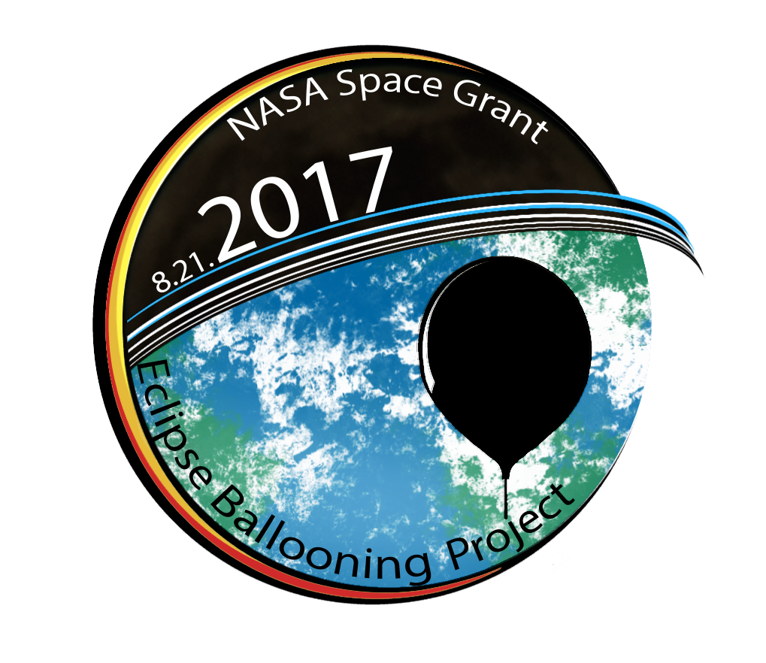
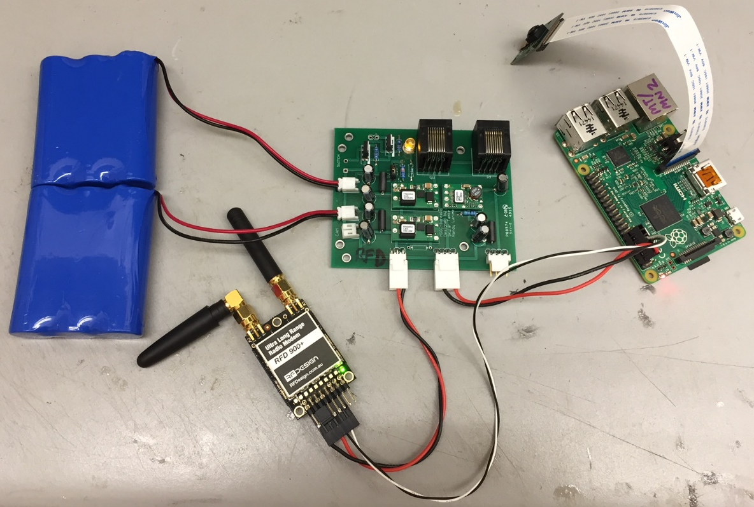
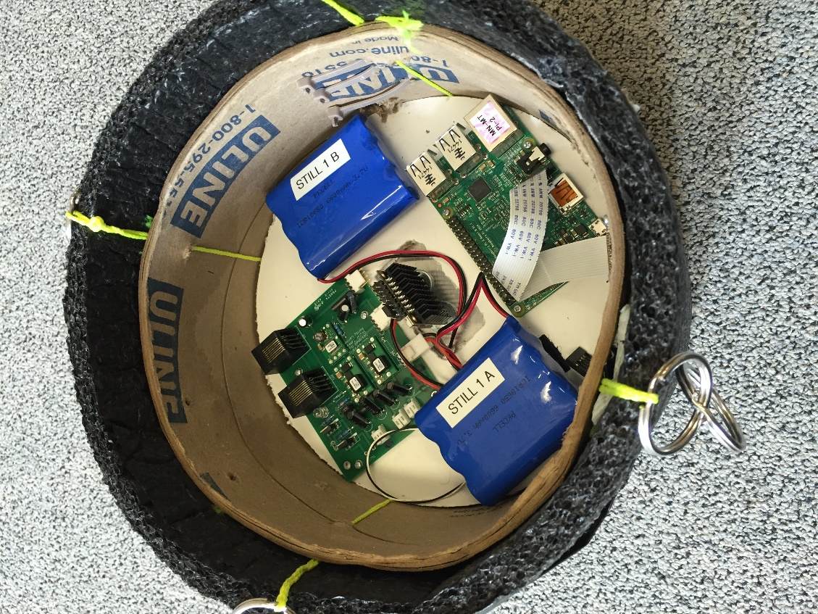
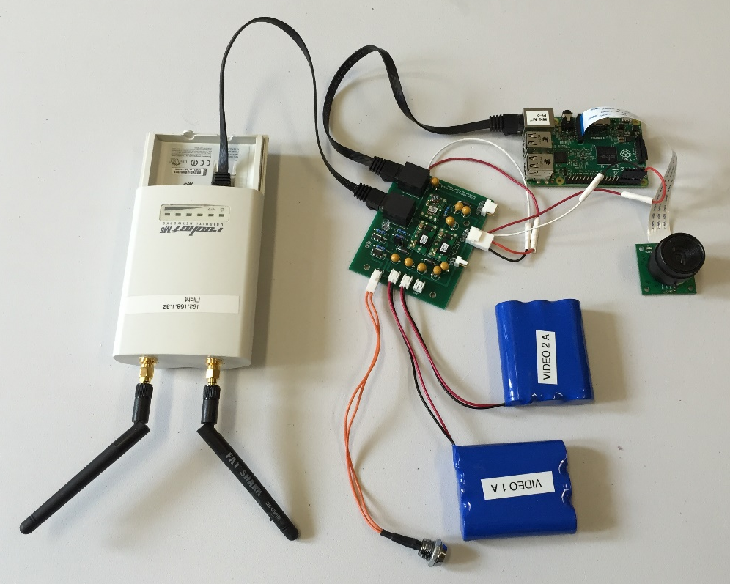
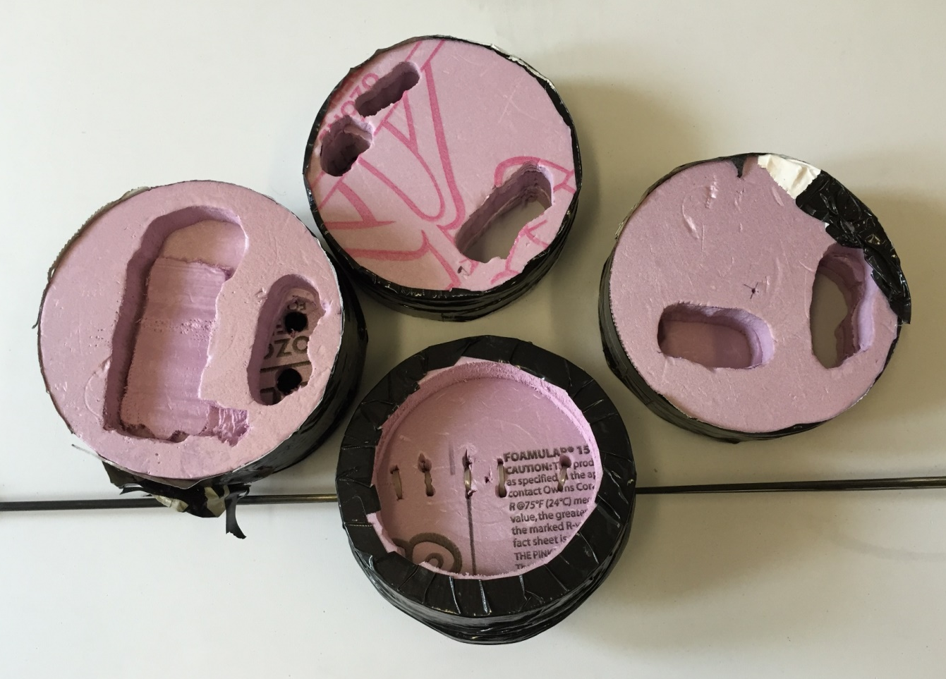
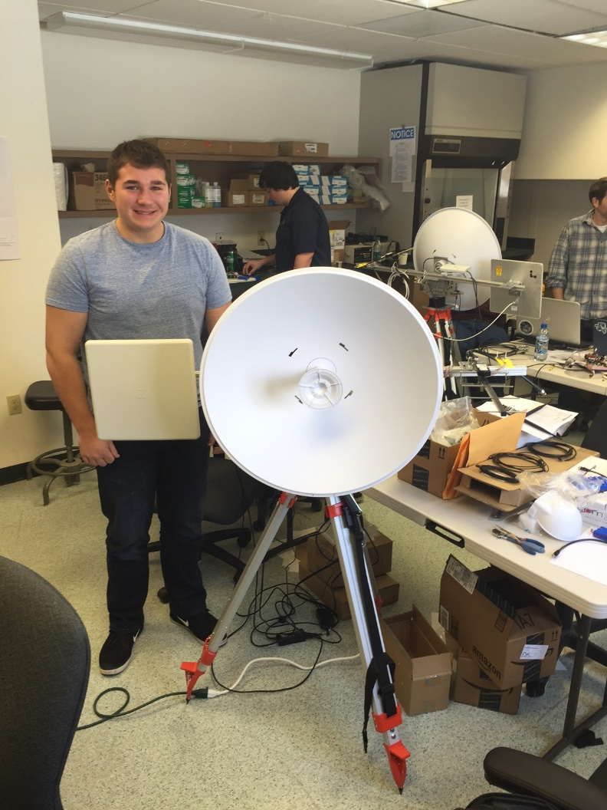
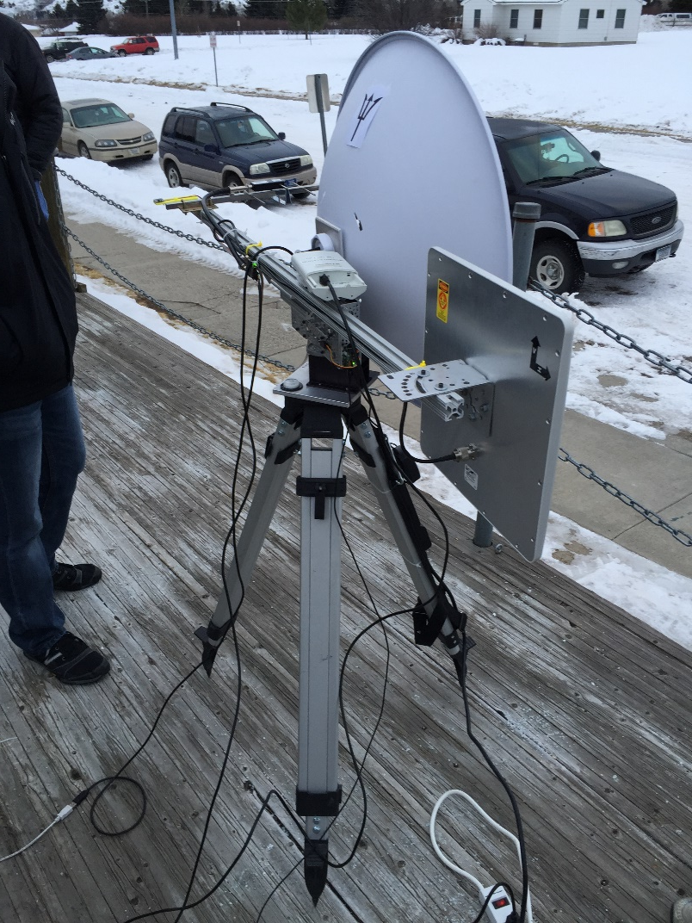
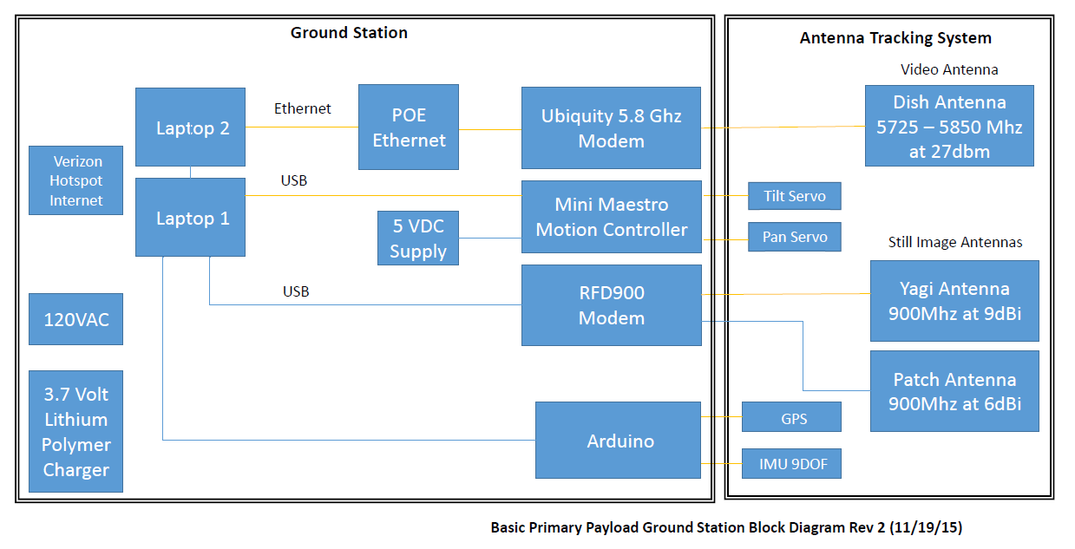
Live Video Telemetry of a Total Solar Eclipse from a
Constellation of Stratospheric Sounding Balloons
Poster by: James Flaten and collaborators, NASA’s Minnesota Space Grant Consortium, University of Minnesota – Twin Cities
Project led by: Angela Des Jardins and collaborators, NASA’s Montana Space Grant Consortium, Montana State University
Also involved: T. Gregory Guzik and collaborators, NASA’s Louisiana Space Grant Consortium, Louisiana State University
Also involved: Chris Koehler and collaborators, NASA’s Colorado Space Grant Consortium, University of Colorado at Boulder
Abstract
Still Photo Flight Unit
Hardware Listing (partial)
On August 21, 2017, the path of totality of a solar eclipse will sweep across the continental United States from Oregon to South Carolina. The “NASA Space Grant Eclipse Ballooning Project” http://eclipse.montana.edu/ is an initiative to develop science payloads to fly on stratospheric sounding balloons (mostly latex weather balloons) into this eclipse. The key technology challenge, tough to achieve with a 6-pound weight limit per payload and a 12-pound total payload stack limit coupled with severe size and cost limits on mobile ground equipment, is to live-stream HD video from the strato-sphere to the ground for posting to the internet in real time from dozens of sounding balloons simultaneously flying on the eclipse path. This initiative is being led by NASA’s Montana Space Grant Consortium and involves ballooning teams from 30 Space Grants across the country, including one at the U of MN – Twin Cities that is funded by NASA’s Minnesota Space Grant Consortium. This poster-plus-hard-ware-exhibit will describe ground station and flight hardware, test results to date, as well as plans for additional hardware and software development prior to the eclipse in 2017.
The still photo flight unit takes regular low-resolution and high-resolution photographs and stores them on the flight Pi. Custom software allows the user to request photos (typically low-res ones) to be transmitted via the RFD900 modem during the flight, which takes over 1 minute per image. The still photos will be higher resolution than video frames, so these are likely to be the best flight photos. This radio link might also be used to uplink camera-pointing commands.
Ground Station Steerable Tripod
Surveyor tripod
Custom antenna mount (Actobotics parts)
Servo motors (2)
Base plate and angle bracket
80/20 channel mounting bars (2)
Ubiquiti light weight dish antenna
Ubiquiti 5.8 GHz Rocket M5 modem
900 MHz Yagi antenna
900 MHz patch antenna
RFD900 modem
Arduino Uno with GPS shield
IMU (for tripod orientation calibration)
Pololu Mini Maestro servo controller
Ground Station Computer(s)
Dedicated laptop(s) running
  Tracking/pointing custom software
  Still photo reception custom software
  Video feed custom software
Satellite Tracking Flight Unit
NAL Iridium satellite modem
NAL antennas – GPS and Iridium
3.7 volt 6600 mAh LiPo battery
Zigbee radio (to relay cutdown commands)
Still Photo Flight Unit
Raspberry Pi 2 Model B (64 Gig SD)
Pi camera (used in still photo mode)
Custom power board
Cabling (some custom)
3.7 volt 6600 mAh LiPo batteries (2)
RFD900 modem
900 MHz quarter wave antennas (2)
Aluminum sheet for ground plane
Video Telemetry Flight Unit
Raspberry Pi 2 Model B (64 Gig SD)
Pi camera (used in video mode)
Custom power board
Cabling (some custom)
3.7 volt 6600 mAh LiPo batteries (2)
Ubiquiti 5.8 GHz Rocket M5 modem
Fat Shark 5.8 GHz antennas (2)
Cutdown
Custom “OCCAMS” razor cutter
Zigbee radio (to talk to Iridium modem)
3.7 volt 6600 mAh LiPo battery
Still photo system components
Video Telemetry Flight Unit
The video telemetry system streams video in real time to the ground through the Ubiquiti modem. The video footage is also stored on the flight Pi. This higher-data-rate connection requires a high-gain, directional antenna on the ground. This real-time view from the balloon might be used to manually point gimbaled cameras from the ground. Another solution, to ensure not missing the eclipse due to pointing, is to use an 8-camera multiplexer with views in 8 directions simultaneously.
Still photo system in payload box
System Overview
Tracking Ground Station
The ground station uses pan and tilt servos to point multiple antennas toward the target (i.e. the balloon), calculating the pointing angles from GPS coordinates of the target and those of the ground station itself. Target GPS coordinates can be fed into the pointing software automatically using the Iridium modem link (accessed via the internet). Or target coordinates from any other on-board radio tracker (such as APRS ham radios) can be entered into the pointing software manually.
Status of Testing/Roll-out
The video/still photo telemetry system for the Space Grant Eclipse Ballooning Project (AKA the “common” payload since many groups will also fly their own unique science payloads) consists of (a) a Raspberry-Pi-based still photo telemetry system with images transmitted using an RFD900 (900 MHz) modem, (b) a Raspberry-Pi-based video telemetry system with the video stream transmitted using a Ubiquiti M5 Rocket (5.8 GHz) modem, (c) a steerable ground tripod with multiple antennas all pointing in the same direction to pick up both still photos (on 900 MHz) and the video feed (on 5.8 GHz), (d) a GPS-enabled Iridium satellite modem to relay tracking data (over the internet) to the ground station for auto-pointing, and (e) a custom razor cutter for flight termination, contacted by Zigbee radio using e-mail messages to the Iridium modem.
During the eclipse, tracking information from Iridium modems on each of dozens of payloads simultaneously in flight will be used by the FAA to monitor balloon locations. The live video feeds from the balloons will be streamed to a central website then one feed at a time will be forwarded to the NASA home page for online viewing in near-real-time.
Video system components
The MT Space Grant is leading the overall design, testing, and roll-out effort and has had several successful balloon flights in which still photos and live video were both transmitted from altitude up to 40 km (adequate for the eclipse mission).
As an “early adopter” in the program, the LA Space Grant has built the ground station and flight hardware and has been conducting environmental chamber tests at low pressures and low temperatures. Their feedback has resulted in changes to the flight packaging and also to the on-board custom power boards.
As an “early adopter” in the program, the MN Space Grant built two full systems in a freshman seminar class, spring 2016, making significant modifications to one. Unfortunately the class flight was hampered by inclement weather so telemetry was
Payload box for video system
was not successfully tested at altitude. Additional ground and flight testing will continue during the summer of 2016 and beyond.
The CO Space Grant has been involved in preparing materials for two summer 2016 training workshops to be held in Bozeman, MT. Nearly 50 teams from 30 states will receive hardware and be trained to use it, after which practice flight events involving multiple teams will commence.
This project has been generously funded by NASA’s “Space Grant and Fellowship Program” (more commonly known as “Space Grant”) and by NASA’s Science Mission Directorate. A total of 30 state Space Grants from around the nation are participating.
This poster was presented at the 2016 Scientific Ballooning Technologies Workshop at the University of Minnesota – Twin Cities.
Ground station front view
Ground station rear view
Block diagram for steerable ground station (MT-SG)

