Slide 1
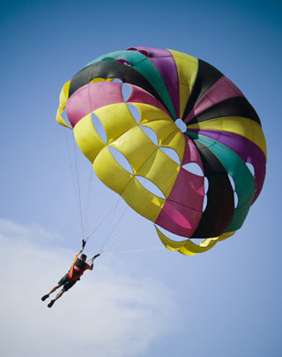
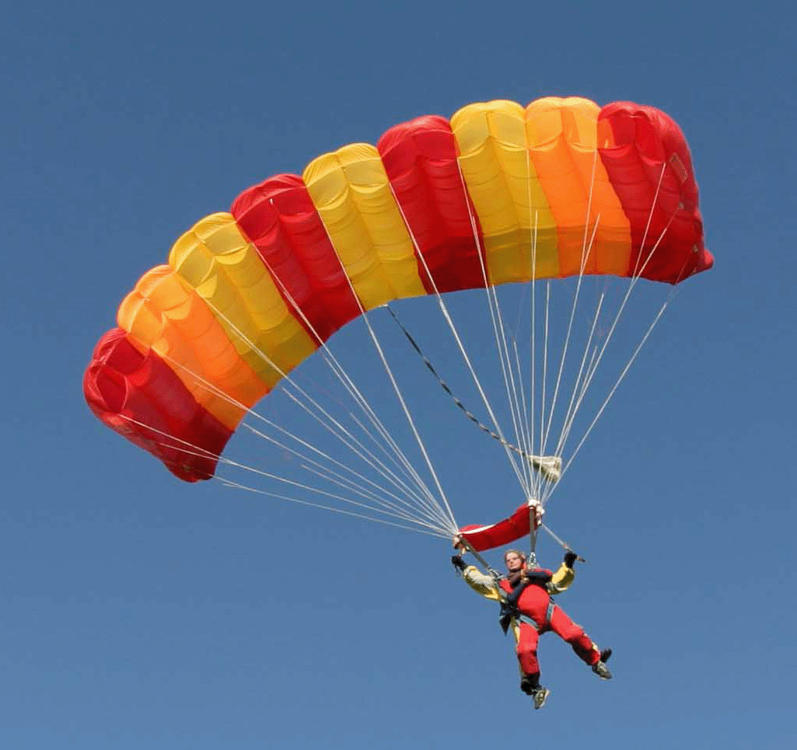
(Building and Testing)
Parachutes
http://www.turkeytourism.in/pages_c.php?id=135
http://redrushvouchers.co.uk/wp-content/uploads/2014/11/parachute-2.gif
James Flaten and U of MN student helpers
NASA’s MN Space Grant Consortium and
U of MN – Aerospace Engineering Department

Slide 2
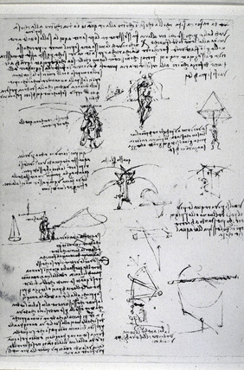
Leonardo Da Vinci (1452-1519) notebook page
showing a parachute designed to hold a person.
http://www.ssplprints.com/image/95274/leonardo-da-vinci-drawings-by-leonardo-da-vinci-of-parachute-experiments-15th-century

Slide 3
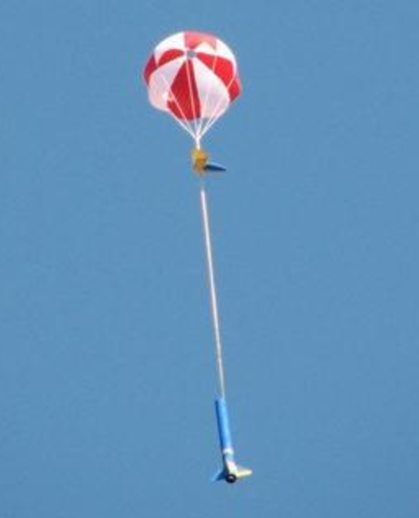
https://giantleaprocketry.com/products/components_recovery.aspx
J. Flaten, U of MN, MnSGC ballooning team photo
Here at the U of MN we use parachutes to bring
high-power rockets and stratospheric balloon
payloads back down at a safe descent rate.

Slide 4
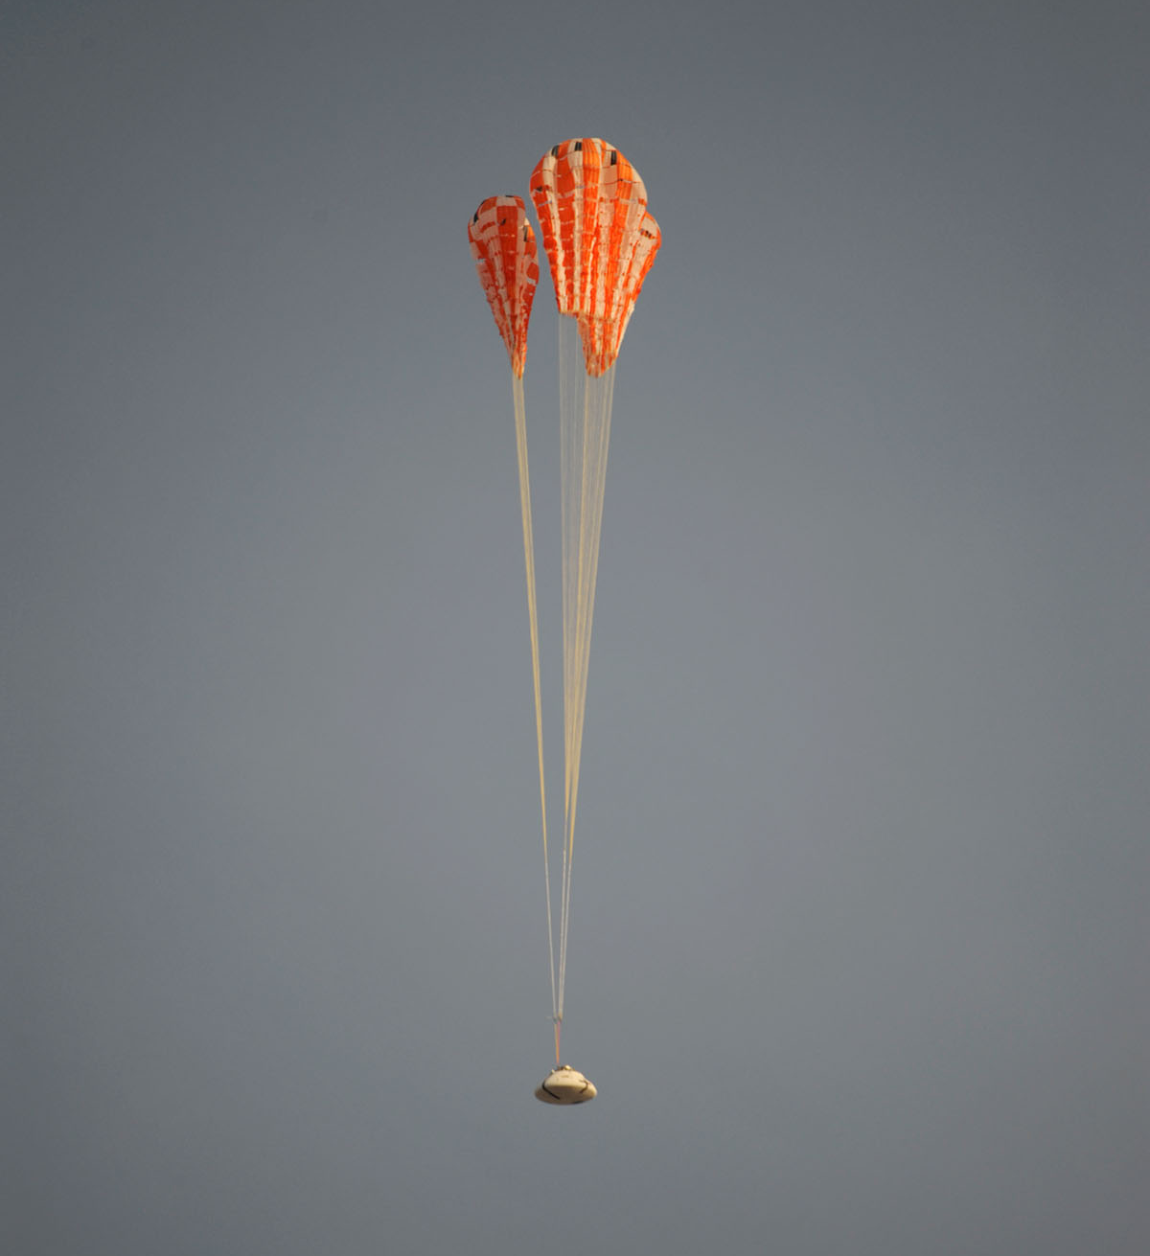
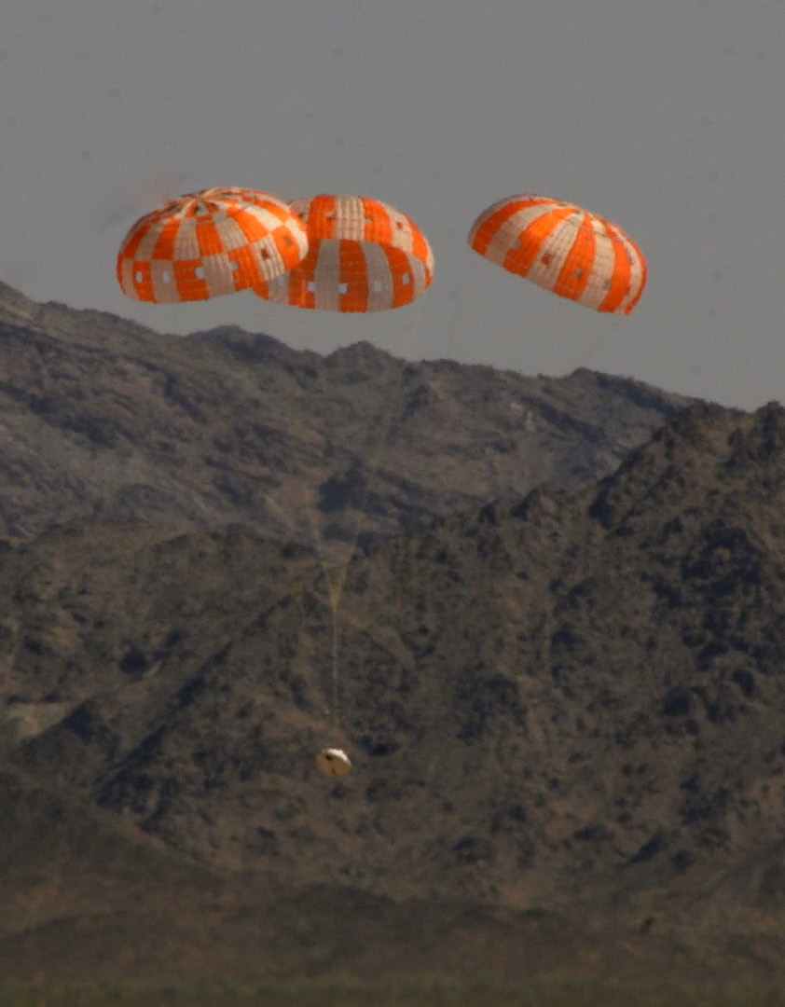
NASA’s Orion capsule – a multi-stage multi-parachute system.
https://www.youtube.com/watch?v=fAMqb77Dmzk

Slide 5
Parachute vocabulary
Canopy – various materials, sizes, shapes
Spill hole (some parachutes have this)
Shroud lines (and possibly a spreader ring)
Payload – weight varies, aerodynamics make a difference
“Drogue” (small/initial) vs “Main” (large/final) parachutes
Deployment speed (e.g. deployment at “Mach 1” or more would be a supersonic parachute)
Terminal velocity (AKA landing speed) (AKA final descent speed)

Slide 6
Parachute considerations
Stowage prior to deployment
Possibility of tangling
Deployment shock
Steerability
Terminal velocity (descent/landing speed)
  Force balance between weight (downward force) and air drag (upward force)
  Drag provided depends on parachute shape/area and speed (and air density)

Slide 7
Parachute activity
Build two parachutes that differ in just one main way – consider modifying
  Canopy size/area
  Canopy shape
  Spill hole size
  Flatness
Do a comparison-drop with identical payloads
Report on findings to the whole group
(If time) Use what you learned to build another parachute to lower a “fragile” payload

